Slide 1
Boolean Logic

Slide 2
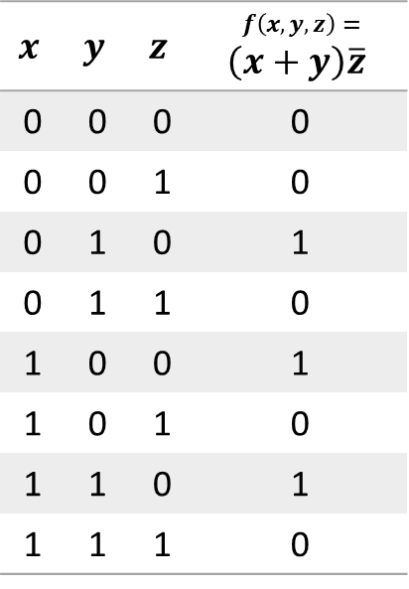
Truth Tables
$$x$$ | $$y$$ | $$z$$ | $$f\left(x,y,z\right)=$$ $$\left(x+y\right)\overline{z}$$
0 | 0 | 0 | 0
0 | 0 | 1 | 0
0 | 1 | 0 | 1
0 | 1 | 1 | 0
1 | 0 | 0 | 1
1 | 0 | 1 | 0
1 | 1 | 0 | 1
1 | 1 | 1 | 0

Slide 3
Truth Tables canonical
$$x$$ | $$y$$ | $$z$$ | $$f\left(x,y,z\right)=$$ $$\left(x+y\right)\overline{z}$$
0 | 0 | 0 | 0
0 | 0 | 1 | 0
0 | 1 | 0 | 1
0 | 1 | 1 | 0
1 | 0 | 0 | 1
1 | 0 | 1 | 0
1 | 1 | 0 | 1
1 | 1 | 1 | 0
Focus on rows where $f\left(x,y,z\right)=1$

Slide 4
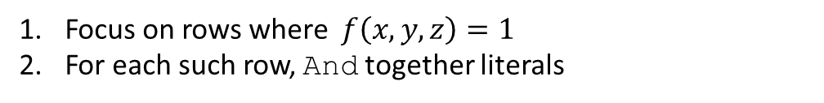
Truth Tables canonical
$$x$$ | $$y$$ | $$z$$ | $$f\left(x,y,z\right)=$$ $$\left(x+y\right)\overline{z}$$
0 | 0 | 0 | 0
0 | 0 | 1 | 0
0 | 1 | 0 | 1
0 | 1 | 1 | 0
1 | 0 | 0 | 1
1 | 0 | 1 | 0
1 | 1 | 0 | 1
1 | 1 | 1 | 0
Focus on rows where $f\left(x,y,z\right)=1$
For each such row, And together literals

Slide 5



Truth Tables canonical
$$x$$ | $$y$$ | $$z$$ | $$f\left(x,y,z\right)=$$ $$\left(x+y\right)\overline{z}$$
0 | 0 | 0 | 0
0 | 0 | 1 | 0
0 | 1 | 0 | 1
0 | 1 | 1 | 0
1 | 0 | 0 | 1
1 | 0 | 1 | 0
1 | 1 | 0 | 1
1 | 1 | 1 | 0
Focus on rows where $f\left(x,y,z\right)=1$
For each such row, And together literals
$$\overline{x}y\overline{z}$$
$$\overline{x}\overline{y}\overline{z}$$
$$xy\overline{z}$$

Slide 6
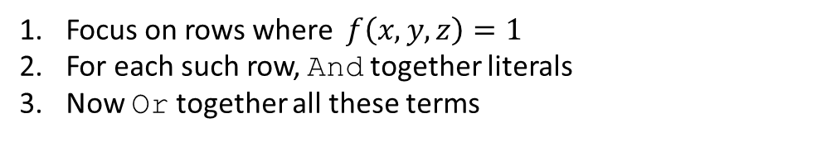
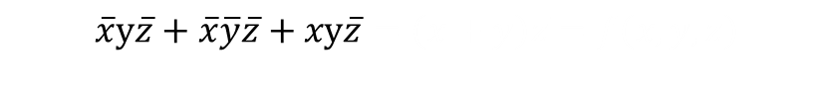
Truth Tables canonical
$$x$$ | $$y$$ | $$z$$ | $$f\left(x,y,z\right)=$$ $$\left(x+y\right)\overline{z}$$
0 | 0 | 0 | 0
0 | 0 | 1 | 0
0 | 1 | 0 | 1
0 | 1 | 1 | 0
1 | 0 | 0 | 1
1 | 0 | 1 | 0
1 | 1 | 0 | 1
1 | 1 | 1 | 0
Focus on rows where $f\left(x,y,z\right)=1$
For each such row, And together literals
Now Or together all these terms
$$\overline{x}y\overline{z}$$
$$\overline{x}\overline{y}\overline{z}$$
$$\overline{x}y\overline{z}+\overline{x}\overline{y}\overline{z}+xy\overline{z}=\left(x+y\right)\overline{z}=f\left(x,y,z\right)$$
$$xy\overline{z}$$

Slide 7
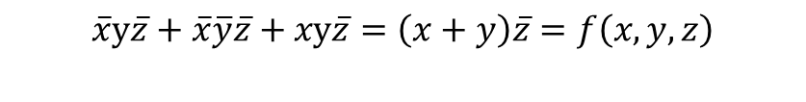
Truth Tables canonical
$$x$$ | $$y$$ | $$z$$ | $$f\left(x,y,z\right)=$$ $$\left(x+y\right)\overline{z}$$
0 | 0 | 0 | 0
0 | 0 | 1 | 0
0 | 1 | 0 | 1
0 | 1 | 1 | 0
1 | 0 | 0 | 1
1 | 0 | 1 | 0
1 | 1 | 0 | 1
1 | 1 | 1 | 0
Focus on rows where $f\left(x,y,z\right)=1$
For each such row, And together literals
Now Or together all these terms
$$\overline{x}y\overline{z}$$
$$\overline{x}\overline{y}\overline{z}$$
$$\overline{x}y\overline{z}+\overline{x}\overline{y}\overline{z}+xy\overline{z}=\left(x+y\right)\overline{z}=f\left(x,y,z\right)$$
$$xy\overline{z}$$
Every Boolean function, no matter how complex, can be expressed using three Boolean operators only: And, Or, and Not.

Slide 8
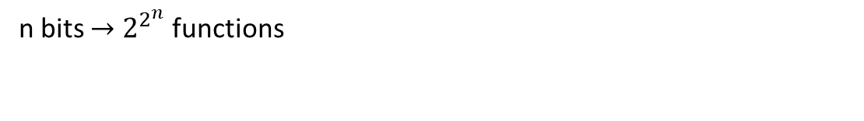
Truth Tables functions
n bits $→$ $2^{2^{n}}$ functions

Slide 9
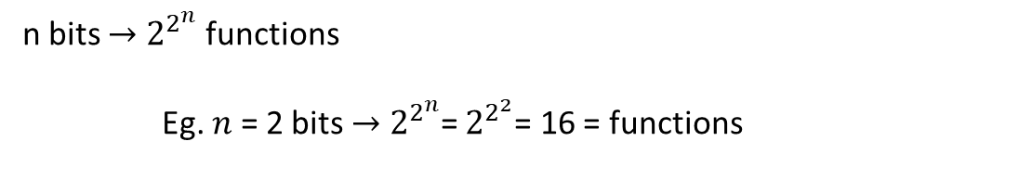
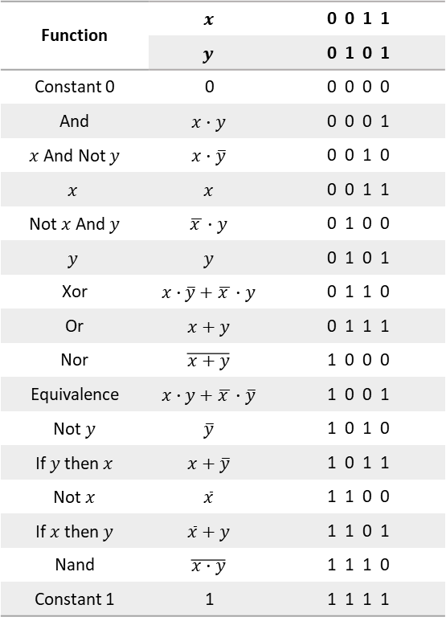
Truth Tables functions
Function | $$x$$ | 0 0 1 1
 | $$y$$ | 0 1 0 1
Constant 0 | 0 | 0 0 0 0
And | $$x∙y$$ | 0 0 0 1
$x$ And Not $y$ | $$x∙\overline{y}$$ | 0 0 1 0
$$x$$ | $$x$$ | 0 0 1 1
Not $x$ And $y$ | $$\overline{x }∙y$$ | 0 1 0 0
$$y$$ | $$y$$ | 0 1 0 1
Xor | $$x∙\overline{y}+\overline{x }∙y$$ | 0 1 1 0
Or | $$x+y$$ | 0 1 1 1
Nor | $$\overline{x+y}$$ | 1 0 0 0
Equivalence | $$x∙y+\overline{x }∙\overline{y}$$ | 1 0 0 1
Not $y$ | $$\overline{y}$$ | 1 0 1 0
If $y$ then $x$ | $$x+\overline{y}$$ | 1 0 1 1
Not $x$ | $$\overline{x}$$ | 1 1 0 0
If $x$ then $y$ | $$\overline{x}+y$$ | 1 1 0 1
Nand | $$\overline{x∙y}$$ | 1 1 1 0
Constant 1 | 1 | 1 1 1 1
n bits $→$ $2^{2^{n}}$ functions
Eg. $n$ = 2 bits $→$ $2^{2^{n}}$= $2^{2^{2}}$= 16 = functions

Slide 10
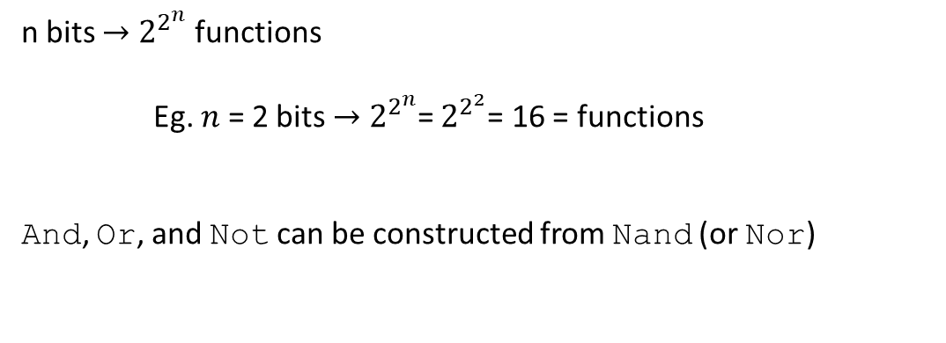
Truth Tables functions
Function | $$x$$ | 0 0 1 1
 | $$y$$ | 0 1 0 1
Constant 0 | 0 | 0 0 0 0
And | $$x∙y$$ | 0 0 0 1
$x$ And Not $y$ | $$x∙\overline{y}$$ | 0 0 1 0
$$x$$ | $$x$$ | 0 0 1 1
Not $x$ And $y$ | $$\overline{x }∙y$$ | 0 1 0 0
$$y$$ | $$y$$ | 0 1 0 1
Xor | $$x∙\overline{y}+\overline{x }∙y$$ | 0 1 1 0
Or | $$x+y$$ | 0 1 1 1
Nor | $$\overline{x+y}$$ | 1 0 0 0
Equivalence | $$x∙y+\overline{x }∙\overline{y}$$ | 1 0 0 1
Not $y$ | $$\overline{y}$$ | 1 0 1 0
If $y$ then $x$ | $$x+\overline{y}$$ | 1 0 1 1
Not $x$ | $$\overline{x}$$ | 1 1 0 0
If $x$ then $y$ | $$\overline{x}+y$$ | 1 1 0 1
Nand | $$\overline{x∙y}$$ | 1 1 1 0
Constant 1 | 1 | 1 1 1 1
n bits $→$ $2^{2^{n}}$ functions
Eg. $n$ = 2 bits $→$ $2^{2^{n}}$= $2^{2^{2}}$= 16 = functions
And, Or, and Not can be constructed from Nand (or Nor)

Slide 11
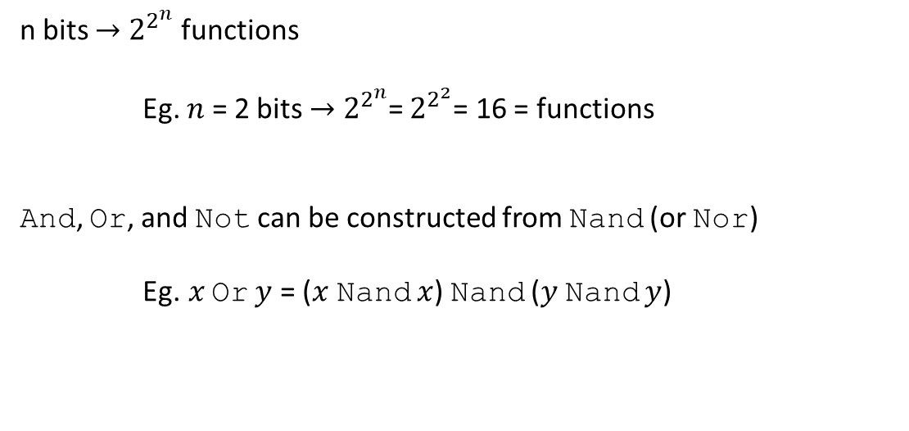
Truth Tables functions
Function | $$x$$ | 0 0 1 1
 | $$y$$ | 0 1 0 1
Constant 0 | 0 | 0 0 0 0
And | $$x∙y$$ | 0 0 0 1
$x$ And Not $y$ | $$x∙\overline{y}$$ | 0 0 1 0
$$x$$ | $$x$$ | 0 0 1 1
Not $x$ And $y$ | $$\overline{x }∙y$$ | 0 1 0 0
$$y$$ | $$y$$ | 0 1 0 1
Xor | $$x∙\overline{y}+\overline{x }∙y$$ | 0 1 1 0
Or | $$x+y$$ | 0 1 1 1
Nor | $$\overline{x+y}$$ | 1 0 0 0
Equivalence | $$x∙y+\overline{x }∙\overline{y}$$ | 1 0 0 1
Not $y$ | $$\overline{y}$$ | 1 0 1 0
If $y$ then $x$ | $$x+\overline{y}$$ | 1 0 1 1
Not $x$ | $$\overline{x}$$ | 1 1 0 0
If $x$ then $y$ | $$\overline{x}+y$$ | 1 1 0 1
Nand | $$\overline{x∙y}$$ | 1 1 1 0
Constant 1 | 1 | 1 1 1 1
n bits $→$ $2^{2^{n}}$ functions
Eg. $n$ = 2 bits $→$ $2^{2^{n}}$= $2^{2^{2}}$= 16 = functions
And, Or, and Not can be constructed from Nand (or Nor)
Eg.$x$ Or $y$ = ($x$Nand $x$) Nand ($y$Nand $y$)

Slide 12
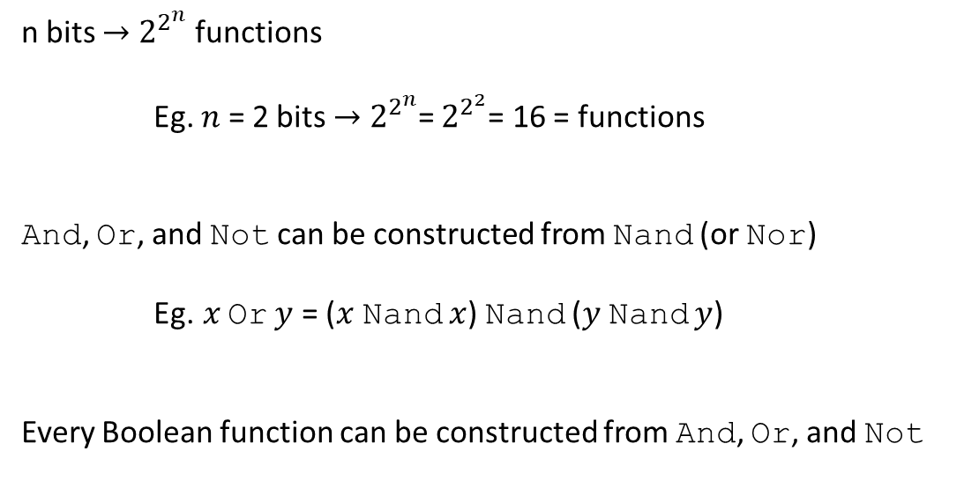
Truth Tables functions
Function | $$x$$ | 0 0 1 1
 | $$y$$ | 0 1 0 1
Constant 0 | 0 | 0 0 0 0
And | $$x∙y$$ | 0 0 0 1
$x$ And Not $y$ | $$x∙\overline{y}$$ | 0 0 1 0
$$x$$ | $$x$$ | 0 0 1 1
Not $x$ And $y$ | $$\overline{x }∙y$$ | 0 1 0 0
$$y$$ | $$y$$ | 0 1 0 1
Xor | $$x∙\overline{y}+\overline{x }∙y$$ | 0 1 1 0
Or | $$x+y$$ | 0 1 1 1
Nor | $$\overline{x+y}$$ | 1 0 0 0
Equivalence | $$x∙y+\overline{x }∙\overline{y}$$ | 1 0 0 1
Not $y$ | $$\overline{y}$$ | 1 0 1 0
If $y$ then $x$ | $$x+\overline{y}$$ | 1 0 1 1
Not $x$ | $$\overline{x}$$ | 1 1 0 0
If $x$ then $y$ | $$\overline{x}+y$$ | 1 1 0 1
Nand | $$\overline{x∙y}$$ | 1 1 1 0
Constant 1 | 1 | 1 1 1 1
n bits $→$ $2^{2^{n}}$ functions
Eg. $n$ = 2 bits $→$ $2^{2^{n}}$= $2^{2^{2}}$= 16 = functions
And, Or, and Not can be constructed from Nand (or Nor)
Eg.$x$ Or $y$ = ($x$Nand $x$) Nand ($y$Nand $y$)
Every Boolean function can be constructed from And, Or, and Not

Slide 13
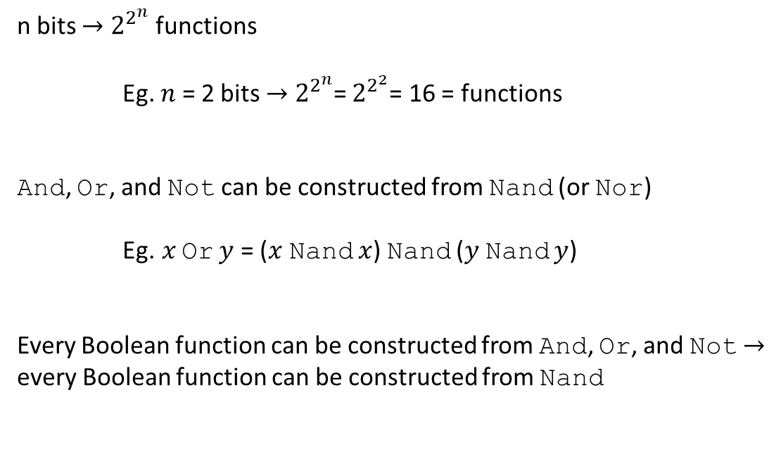
Truth Tables functions
Function | $$x$$ | 0 0 1 1
 | $$y$$ | 0 1 0 1
Constant 0 | 0 | 0 0 0 0
And | $$x∙y$$ | 0 0 0 1
$x$ And Not $y$ | $$x∙\overline{y}$$ | 0 0 1 0
$$x$$ | $$x$$ | 0 0 1 1
Not $x$ And $y$ | $$\overline{x }∙y$$ | 0 1 0 0
$$y$$ | $$y$$ | 0 1 0 1
Xor | $$x∙\overline{y}+\overline{x }∙y$$ | 0 1 1 0
Or | $$x+y$$ | 0 1 1 1
Nor | $$\overline{x+y}$$ | 1 0 0 0
Equivalence | $$x∙y+\overline{x }∙\overline{y}$$ | 1 0 0 1
Not $y$ | $$\overline{y}$$ | 1 0 1 0
If $y$ then $x$ | $$x+\overline{y}$$ | 1 0 1 1
Not $x$ | $$\overline{x}$$ | 1 1 0 0
If $x$ then $y$ | $$\overline{x}+y$$ | 1 1 0 1
Nand | $$\overline{x∙y}$$ | 1 1 1 0
Constant 1 | 1 | 1 1 1 1
n bits $→$ $2^{2^{n}}$ functions
Eg. $n$ = 2 bits $→$ $2^{2^{n}}$= $2^{2^{2}}$= 16 = functions
And, Or, and Not can be constructed from Nand (or Nor)
Eg.$x$ Or $y$ = ($x$Nand $x$) Nand ($y$Nand $y$)
Every Boolean function can be constructed from And, Or, and Not $→$ every Boolean function can be constructed from Nand

Slide 14
Truth Tables functions
Function | $$x$$ | 0 0 1 1
 | $$y$$ | 0 1 0 1
Constant 0 | 0 | 0 0 0 0
And | $$x∙y$$ | 0 0 0 1
$x$ And Not $y$ | $$x∙\overline{y}$$ | 0 0 1 0
$$x$$ | $$x$$ | 0 0 1 1
Not $x$ And $y$ | $$\overline{x }∙y$$ | 0 1 0 0
$$y$$ | $$y$$ | 0 1 0 1
Xor | $$x∙\overline{y}+\overline{x }∙y$$ | 0 1 1 0
Or | $$x+y$$ | 0 1 1 1
Nor | $$\overline{x+y}$$ | 1 0 0 0
Equivalence | $$x∙y+\overline{x }∙\overline{y}$$ | 1 0 0 1
Not $y$ | $$\overline{y}$$ | 1 0 1 0
If $y$ then $x$ | $$x+\overline{y}$$ | 1 0 1 1
Not $x$ | $$\overline{x}$$ | 1 1 0 0
If $x$ then $y$ | $$\overline{x}+y$$ | 1 1 0 1
Nand | $$\overline{x∙y}$$ | 1 1 1 0
Constant 1 | 1 | 1 1 1 1
n bits $→$ $2^{2^{n}}$ functions
Eg. $n$ = 2 bits $→$ $2^{2^{n}}$= $2^{2^{2}}$= 16 = functions
And, Or, and Not can be constructed from Nand (or Nor)
Eg.$x$ Or $y$ = ($x$Nand $x$) Nand ($y$Nand $y$)
Every Boolean function can be constructed from And, Or, and Not $→$ every Boolean function can be constructed from Nand

Slide 15
Truth Tables gates
Primitive gates

Slide 16



Truth Tables gates
Primitive gates
And(a,b) Or(a,b) Not(in)
a a
out out in out
b b
$$a∙b=out$$
$$a+b=out$$
$$\overline{in}=out$$

Slide 17
Truth Tables gates
Primitive gates
And(a,b) Or(a,b) Not(in)
Composite gates
a a
out out in out
b b
$$a∙b=out$$
$$a+b=out$$
$$\overline{in}=out$$

Slide 18

Truth Tables gates
Primitive gates
And(a,b) Or(a,b) Not(in)
Composite gates
Eg. three-way And
a a
out out in out
b b
$$a∙b=out$$
$$a+b=out$$
$$\overline{in}=out$$
a
b out
c
And(a,b,c)
$$a∙b∙c=out$$

Slide 19
Truth Tables gates
Primitive gates
And(a,b) Or(a,b) Not(in)
Composite gates
Eg. three-way And
a a
out out in out
b b
$$a∙b=out$$
$$a+b=out$$
$$\overline{in}=out$$
a
b out
c
And(a,b,c)
$$a∙b∙c=out$$

Slide 20

Truth Tables gates
Primitive gates
And(a,b) Or(a,b) Not(in)
Composite gates
Eg. three-way And
a a
out out in out
b b
$$a∙b=out$$
$$a+b=out$$
$$\overline{in}=out$$
a
b
c
a
b out
out
c
And(a,b,c)
$$a∙b∙c=out$$
($a∙b)∙c=out$

Slide 21
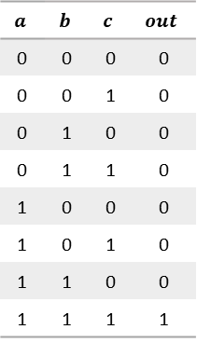
Truth Tables gates
Primitive gates
And(a,b) Or(a,b) Not(in)
Composite gates
Eg. three-way And
a a
out out in out
b b
$$a∙b=out$$
$$a+b=out$$
$$\overline{in}=out$$
a
b
c
$$a$$ | $$b$$ | $$c$$ | $$out$$
0 | 0 | 0 | 0
0 | 0 | 1 | 0
0 | 1 | 0 | 0
0 | 1 | 1 | 0
1 | 0 | 0 | 0
1 | 0 | 1 | 0
1 | 1 | 0 | 0
1 | 1 | 1 | 1
a
b out
out
c
And(a,b,c)
$$a∙b∙c=out$$
($a∙b)∙c=out$

Slide 22
Truth Tables gates
Primitive gates
And(a,b) Or(a,b) Not(in)
Composite gates
Eg. three-way And
a a
out out in out
b b
$$a∙b=out$$
$$a+b=out$$
$$\overline{in}=out$$
interface
interface
a
b
c
$$a$$ | $$b$$ | $$c$$ | $$out$$
0 | 0 | 0 | 0
0 | 0 | 1 | 0
0 | 1 | 0 | 0
0 | 1 | 1 | 0
1 | 0 | 0 | 0
1 | 0 | 1 | 0
1 | 1 | 0 | 0
1 | 1 | 1 | 1
a
b out
out
c
interface
And(a,b,c)
$$a∙b∙c=out$$
($a∙b)∙c=out$

Slide 23
Truth Tables gates
Primitive gates
And(a,b) Or(a,b) Not(in)
Composite gates
Eg. three-way And
a a
out out in out
b b
$$a∙b=out$$
$$a+b=out$$
$$\overline{in}=out$$
interface
implementation
interface
a
b
c
$$a$$ | $$b$$ | $$c$$ | $$out$$
0 | 0 | 0 | 0
0 | 0 | 1 | 0
0 | 1 | 0 | 0
0 | 1 | 1 | 0
1 | 0 | 0 | 0
1 | 0 | 1 | 0
1 | 1 | 0 | 0
1 | 1 | 1 | 1
a
b out
out
c
interface
And(a,b,c)
$$a∙b∙c=out$$
($a∙b)∙c=out$

Slide 24
Truth Tables gates
Primitive gates
And(a,b) Or(a,b) Not(in)
Composite gates
Eg. Xor
a a
out out in out
b b
$$a∙b=out$$
$$a+b=out$$
$$\overline{in}=out$$

Slide 25

Truth Tables gates
Primitive gates
And(a,b) Or(a,b) Not(in)
Composite gates
Eg. Xor
a a
out out in out
b b
$$a∙b=out$$
$$a+b=out$$
$$\overline{in}=out$$
a
out
b
Xor(a,b)
$$a∙\overline{b}+\overline{a }∙b=out$$

Slide 26

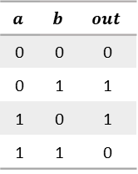
Truth Tables gates
Primitive gates
And(a,b) Or(a,b) Not(in)
Composite gates
Eg. Xor
a a
out out in out
b b
$$a∙b=out$$
$$a+b=out$$
$$\overline{in}=out$$
a
b
a
$$a$$ | $$b$$ | $$out$$
0 | 0 | 0
0 | 1 | 1
1 | 0 | 1
1 | 1 | 0
out out
b
Xor(a,b) = Or(And(a,Not(b)), And(b,Not(a)))
$$a∙\overline{b}+\overline{a }∙b=out$$
$$a∙\overline{b}+\overline{a }∙b=out$$

Slide 27
Truth Tables gates
Primitive gates
And(a,b) Or(a,b) Not(in)
Composite gates
Eg. Xor
a a
out out in out
b b
$$a∙b=out$$
$$a+b=out$$
$$\overline{in}=out$$
a
b
a
$$a$$ | $$b$$ | $$out$$
0 | 0 | 0
0 | 1 | 1
1 | 0 | 1
1 | 1 | 0
out out
b
Xor(a,b) = Or(And(a,Not(b)), And(b,Not(a)))
$$a∙\overline{b}+\overline{a }∙b=out$$
$$a∙\overline{b}+\overline{a }∙b=out$$

Slide 28
Truth Tables gates
Primitive gates
And(a,b) Or(a,b) Not(in)
Composite gates
Eg. Xor
a a
out out in out
b b
$$a∙b=out$$
$$a+b=out$$
$$\overline{in}=out$$
a
b
a
$$a$$ | $$b$$ | $$out$$
0 | 0 | 0
0 | 1 | 1
1 | 0 | 1
1 | 1 | 0
out out
b
Xor(a,b) = Or(And(a,Not(b)), And(b,Not(a)))
$$a∙\overline{b}+\overline{a }∙b=out$$
$$a∙\overline{b}+\overline{a }∙b=out$$

Slide 29
Truth Tables gates
Primitive gates
And(a,b) Or(a,b) Not(in)
Composite gates
Eg. Xor
a a
out out in out
b b
$$a∙b=out$$
$$a+b=out$$
$$\overline{in}=out$$
a
b
a
$$a$$ | $$b$$ | $$out$$
0 | 0 | 0
0 | 1 | 1
1 | 0 | 1
1 | 1 | 0
out out
b
Xor(a,b) = Or(And(a,Not(b)), And(b,Not(a)))
$$a∙\overline{b}+\overline{a }∙b=out$$
$$a∙\overline{b}+\overline{a }∙b=out$$

Slide 30
Truth Tables gates
Primitive gates
And(a,b) Or(a,b) Not(in)
Composite gates
Eg. Xor
a a
out out in out
b b
$$a∙b=out$$
$$a+b=out$$
$$\overline{in}=out$$
single interface
a
b
single interface
a
$$a$$ | $$b$$ | $$out$$
0 | 0 | 0
0 | 1 | 1
1 | 0 | 1
1 | 1 | 0
out out
b
single interface
Xor(a,b) = Or(And(a,Not(b)), And(b,Not(a)))
$$a∙\overline{b}+\overline{a }∙b=out$$
$$a∙\overline{b}+\overline{a }∙b=out$$

Slide 31
Truth Tables gates
Primitive gates
And(a,b) Or(a,b) Not(in)
Composite gates
Eg. Xor
a a
out out in out
b b
$$a∙b=out$$
$$a+b=out$$
$$\overline{in}=out$$
single interface
a
b
single interface
a
$$a$$ | $$b$$ | $$out$$
0 | 0 | 0
0 | 1 | 1
1 | 0 | 1
1 | 1 | 0
out out
b
single interface
Xor(a,b) = Or(And(a,Not(b)), And(b,Not(a)))
multiple
Implementations
(5 gates)
$$a∙\overline{b}+\overline{a }∙b=out$$
$$a∙\overline{b}+\overline{a }∙b=out$$

Slide 32

Truth Tables gates
Primitive gates
And(a,b) Or(a,b) Not(in)
Composite gates
Eg. Xor
a a
out out in out
b b
$$a∙b=out$$
$$a+b=out$$
$$\overline{in}=out$$
single interface
a
b
single interface
a
$$a$$ | $$b$$ | $$out$$
0 | 0 | 0
0 | 1 | 1
1 | 0 | 1
1 | 1 | 0
out out
b
single interface
Xor(a,b) = Nand(Nand(a,Nand(a,b)), Nand(b, Nand(a,b)))
multiple
Implementations
(4 gates)
$$a∙\overline{b}+\overline{a }∙b=out$$
$$\overline{\overline{a∙\overline{a∙b}}∙\overline{b∙\overline{a∙b}}}$$

Slide 33
HDL chip
HDL program
/* Xor (exclusive or) gate:
If a<>b out=1 else out=0. */
CHIP Xor {
IN a, b;
OUT out;
PARTS:
Not(in=a, out=nota);
Not(in=b, out=notb);
And(a=a, b=notb, out=w1);
And(a=nota, b=b, out=w2);
Or(a=w1, b=w2, out=out);
}

Slide 34
HDL chip
HDL program
/* Xor (exclusive or) gate:
If a<>b out=1 else out=0. */
CHIP Xor {
IN a, b;
OUT out;
PARTS:
Not(in=a, out=nota);
Not(in=b, out=notb);
And(a=a, b=notb, out=w1);
And(a=nota, b=b, out=w2);
Or(a=w1, b=w2, out=out);
}
CHIP Xor
a
out = 0
b

Slide 35
HDL chip
HDL program
/* Xor (exclusive or) gate:
If a<>b out=1 else out=0. */
CHIP Xor {
IN a, b;
OUT out;
PARTS:
Not(in=a, out=nota);
Not(in=b, out=notb);
And(a=a, b=notb, out=w1);
And(a=nota, b=b, out=w2);
Or(a=w1, b=w2, out=out);
}
CHIP Xor
IN
OUT
header
a
out = 0
b

Slide 36
HDL chip
HDL program
/* Xor (exclusive or) gate:
If a<>b out=1 else out=0. */
CHIP Xor {
IN a, b;
OUT out;
PARTS:
Not(in=a, out=nota);
Not(in=b, out=notb);
And(a=a, b=notb, out=w1);
And(a=nota, b=b, out=w2);
Or(a=w1, b=w2, out=out);
}
CHIP Xor
IN
OUT
header
a
out = 0
b

Slide 37
HDL chip
HDL program
/* Xor (exclusive or) gate:
If a<>b out=1 else out=0. */
CHIP Xor {
IN a, b;
OUT out;
PARTS:
Not(in=a, out=nota);
Not(in=b, out=notb);
And(a=a, b=notb, out=w1);
And(a=nota, b=b, out=w2);
Or(a=w1, b=w2, out=out);
}
CHIP Xor
IN
OUT
header
a
out = 0
b

Slide 38
HDL chip
HDL program
/* Xor (exclusive or) gate:
If a<>b out=1 else out=0. */
CHIP Xor {
IN a, b;
OUT out;
PARTS:
Not(in=a, out=nota);
Not(in=b, out=notb);
And(a=a, b=notb, out=w1);
And(a=nota, b=b, out=w2);
Or(a=w1, b=w2, out=out);
}
CHIP Xor
IN
OUT
header
a
out
b

Slide 39
HDL chip
HDL program
/* Xor (exclusive or) gate:
If a<>b out=1 else out=0. */
CHIP Xor {
IN a, b;
OUT out;
PARTS:
Not(in=a, out=nota);
Not(in=b, out=notb);
And(a=a, b=notb, out=w1);
And(a=nota, b=b, out=w2);
Or(a=w1, b=w2, out=out);
}
CHIP Xor
IN
OUT
header
a
out
parts
b

Slide 40
HDL chip
HDL program
/* Xor (exclusive or) gate:
If a<>b out=1 else out=0. */
CHIP Xor {
IN a, b;
OUT out;
PARTS:
Not(in=a, out=nota);
Not(in=b, out=notb);
And(a=a, b=notb, out=w1);
And(a=nota, b=b, out=w2);
Or(a=w1, b=w2, out=out);
}
CHIP Xor
IN
OUT
header
a
out = 0
parts
a
in out
nota
b

Slide 41
HDL chip
HDL program
/* Xor (exclusive or) gate:
If a<>b out=1 else out=0. */
CHIP Xor {
IN a, b;
OUT out;
PARTS:
Not(in=a, out=nota);
Not(in=b, out=notb);
And(a=a, b=notb, out=w1);
And(a=nota, b=b, out=w2);
Or(a=w1, b=w2, out=out);
}
CHIP Xor
IN
OUT
header
a
out = 0
parts
a
in out
nota
b

Slide 42
HDL chip
HDL program
/* Xor (exclusive or) gate:
If a<>b out=1 else out=0. */
CHIP Xor {
IN a, b;
OUT out;
PARTS:
Not(in=a, out=nota);
Not(in=b, out=notb);
And(a=a, b=notb, out=w1);
And(a=nota, b=b, out=w2);
Or(a=w1, b=w2, out=out);
}
CHIP Xor
IN
OUT
header
a
out = 0
parts
a
in out
nota
b

Slide 43
HDL chip
HDL program
/* Xor (exclusive or) gate:
If a<>b out=1 else out=0. */
CHIP Xor {
IN a, b;
OUT out;
PARTS:
Not(in=a, out=nota);
Not(in=b, out=notb);
And(a=a, b=notb, out=w1);
And(a=nota, b=b, out=w2);
Or(a=w1, b=w2, out=out);
}
CHIP Xor
IN
OUT
header
a
b
in out
notb
out
parts
a
in out
nota
b

Slide 44
HDL chip
HDL program
/* Xor (exclusive or) gate:
If a<>b out=1 else out=0. */
CHIP Xor {
IN a, b;
OUT out;
PARTS:
Not(in=a, out=nota);
Not(in=b, out=notb);
And(a=a, b=notb, out=w1);
And(a=nota, b=b, out=w2);
Or(a=w1, b=w2, out=out);
}
CHIP Xor
IN
OUT
header
a
a
a
b
w1
b
in out
notb
out
out
parts
a
in out
nota
b

Slide 45
HDL chip
HDL program
/* Xor (exclusive or) gate:
If a<>b out=1 else out=0. */
CHIP Xor {
IN a, b;
OUT out;
PARTS:
Not(in=a, out=nota);
Not(in=b, out=notb);
And(a=a, b=notb, out=w1);
And(a=nota, b=b, out=w2);
Or(a=w1, b=w2, out=out);
}
CHIP Xor
IN
OUT
header
a
a
a
b
w1
b
in out
notb
out
out
parts
a
in out
nota
a
b
b
b
out
w2 = 0

Slide 46
HDL chip
HDL program
/* Xor (exclusive or) gate:
If a<>b out=1 else out=0. */
CHIP Xor {
IN a, b;
OUT out;
PARTS:
Not(in=a, out=nota);
Not(in=b, out=notb);
And(a=a, b=notb, out=w1);
And(a=nota, b=b, out=w2);
Or(a=w1, b=w2, out=out);
}
CHIP Xor
IN
OUT
header
a
a
a
b
w1
b
in out
notb
out
a
b
out
out
parts
a
in out
nota
a
b
b
b
out
w2 = 0

Slide 47
HDL chip
HDL program
/* Xor (exclusive or) gate:
If a<>b out=1 else out=0. */
CHIP Xor {
IN a, b;
OUT out;
PARTS:
Not(in=a, out=nota);
Not(in=b, out=notb);
And(a=a, b=notb, out=w1);
And(a=nota, b=b, out=w2);
Or(a=w1, b=w2, out=out);
}
CHIP Xor
IN
OUT
interface
header
a
a
a
b
w1
b
in out
notb
out
a
b
out = 0
out
parts
a
in out
nota
a
b
b
b
out
w2 = 0

Slide 48
HDL chip
HDL program
/* Xor (exclusive or) gate:
If a<>b out=1 else out=0. */
CHIP Xor {
IN a, b;
OUT out;
PARTS:
Not(in=a, out=nota);
Not(in=b, out=notb);
And(a=a, b=notb, out=w1);
And(a=nota, b=b, out=w2);
Or(a=w1, b=w2, out=out);
}
CHIP Xor
IN
OUT
interface
header
a
a
a
b
w1
b
in out
notb
out
a
b
out = 0
out
parts
implementation
a
nota
in out
a
b
b
b
out
w2 = 0

Slide 49
HDL testing
HDL program
Test script (Xor.tst)
/* Xor (exclusive or) gate:
If a<>b out=1 else out=0. */
CHIP Xor {
IN a, b;
OUT out;
PARTS:
Not(in=a, out=nota);
Not(in=b, out=notb);
And(a=a, b=notb, out=w1);
And(a=nota, b=b, out=w2);
Or(a=w1, b=w2, out=out);
}
CHIP Xor
IN
OUT
a
a
a
b
b
notb
out
w1
in out
a
b
out = 0
out
a
in out
nota
a
b
b
b
out
w2 = 0

Slide 50
HDL testing
HDL program
Test script (Xor.tst)
/* Xor (exclusive or) gate:
If a<>b out=1 else out=0. */
CHIP Xor {
IN a, b;
OUT out;
PARTS:
Not(in=a, out=nota);
Not(in=b, out=notb);
And(a=a, b=notb, out=w1);
And(a=nota, b=b, out=w2);
Or(a=w1, b=w2, out=out);
}
CHIP Xor
IN
OUT
a
a
a
b
b
notb
out
w1
in out
a
b
out = 0
out
a
in out
nota
a
b
b
b
out
w2 = 0
load Xor.hdl,
output-list a, b, out;
set a 0, set b 0,
eval, output;
set a 0, set b 1,
eval, output;
set a 1, set b 0,
eval, output;
set a 1, set b 1,
eval, output;

Slide 51
HDL testing
HDL program
Test script (Xor.tst)
/* Xor (exclusive or) gate:
If a<>b out=1 else out=0. */
CHIP Xor {
IN a, b;
OUT out;
PARTS:
Not(in=a, out=nota);
Not(in=b, out=notb);
And(a=a, b=notb, out=w1);
And(a=nota, b=b, out=w2);
Or(a=w1, b=w2, out=out);
}
CHIP Xor
IN
OUT
a
a
a
b
b
notb
out
w1
in out
a
b
out = 0
out
a
in out
nota
a
b
b
b
out
w2 = 0
load Xor.hdl, // load Xor program
output-list a, b, out; // get ready to print value of variables a, b, and out
set a 0, set b 0, // set a = 0 and b = 0
eval, output; // compute and print result
set a 0, set b 1, // set a = 0 and b = 1
eval, output; // compute and print result
set a 1, set b 0, // set a = 1 and b = 0
eval, output; // compute and print result
set a 1, set b 1, // set a = 1 and b = 1
eval, output; // compute and print result

Slide 52
HDL testing
HDL program
Test script (Xor.tst)
/* Xor (exclusive or) gate:
If a<>b out=1 else out=0. */
CHIP Xor {
IN a, b;
OUT out;
PARTS:
Not(in=a, out=nota);
Not(in=b, out=notb);
And(a=a, b=notb, out=w1);
And(a=nota, b=b, out=w2);
Or(a=w1, b=w2, out=out);
}
CHIP Xor
IN
OUT
a
a
a
b
b
notb
out
w1
in out
a
b
out = 0
out
a
in out
nota
a
b
b
b
out
w2 = 0
load Xor.hdl, // load Xor program
output-list a, b, out; // get ready to print value of variables a, b, and out
set a 0, set b 0, // set a = 0 and b = 0
eval, output; // compute and print result
set a 0, set b 1, // set a = 0 and b = 1
eval, output; // compute and print result
set a 1, set b 0, // set a = 1 and b = 0
eval, output; // compute and print result
set a 1, set b 1, // set a = 1 and b = 1
eval, output; // compute and print result

Slide 53
HDL testing
HDL program
Test script (Xor.tst)
/* Xor (exclusive or) gate:
If a<>b out=1 else out=0. */
CHIP Xor {
IN a, b;
OUT out;
PARTS:
Not(in=a, out=nota);
Not(in=b, out=notb);
And(a=a, b=notb, out=w1);
And(a=nota, b=b, out=w2);
Or(a=w1, b=w2, out=out);
}
CHIP Xor
IN
OUT
a
a
a
b
b
notb
out
w1
in out
a
b
out = 0
out
a
in out
nota
a
b
b
b
out
w2 = 0
load Xor.hdl, // load Xor program
output-list a, b, out; // get ready to print value of variables a, b, and out
set a 0, set b 0, // set a = 0 and b = 0
eval, output; // compute and print result
set a 0, set b 1, // set a = 0 and b = 1
eval, output; // compute and print result
set a 1, set b 0, // set a = 1 and b = 0
eval, output; // compute and print result
set a 1, set b 1, // set a = 1 and b = 1
eval, output; // compute and print result
Output file (Xor.out)
a | b | out
-----------

Slide 54
HDL testing
HDL program
Test script (Xor.tst)
/* Xor (exclusive or) gate:
If a<>b out=1 else out=0. */
CHIP Xor {
IN a, b;
OUT out;
PARTS:
Not(in=a, out=nota);
Not(in=b, out=notb);
And(a=a, b=notb, out=w1);
And(a=nota, b=b, out=w2);
Or(a=w1, b=w2, out=out);
}
CHIP Xor
IN
OUT
a = 0
a = 0
a
b
b = 0
notb = 1
out
w1 = 0
in out
a
b
out = 0
out
a = 0
in out
nota = 1
a
b
b = 0
b = 0
out
w2 = 0
load Xor.hdl, // load Xor program
output-list a, b, out; // get ready to print value of variables a, b, and out
set a 0, set b 0, // set a = 0 and b = 0
eval, output; // compute and print result
set a 0, set b 1, // set a = 0 and b = 1
eval, output; // compute and print result
set a 1, set b 0, // set a = 1 and b = 0
eval, output; // compute and print result
set a 1, set b 1, // set a = 1 and b = 1
eval, output; // compute and print result
Output file (Xor.out)
a | b | out
-----------
0 | 0 |

Slide 55
HDL testing
HDL program
Test script (Xor.tst)
/* Xor (exclusive or) gate:
If a<>b out=1 else out=0. */
CHIP Xor {
IN a, b;
OUT out;
PARTS:
Not(in=a, out=nota);
Not(in=b, out=notb);
And(a=a, b=notb, out=w1);
And(a=nota, b=b, out=w2);
Or(a=w1, b=w2, out=out);
}
CHIP Xor
IN
OUT
a = 0
a = 0
a
b
b = 0
notb = 1
out
w1 = 0
in out
a
b
out = 0
out
a = 0
in out
nota = 1
a
b
b = 0
b = 0
out
w2 = 0
load Xor.hdl, // load Xor program
output-list a, b, out; // get ready to print value of variables a, b, and out
set a 0, set b 0, // set a = 0 and b = 0
eval, output; // compute and print result
set a 0, set b 1, // set a = 0 and b = 1
eval, output; // compute and print result
set a 1, set b 0, // set a = 1 and b = 0
eval, output; // compute and print result
set a 1, set b 1, // set a = 1 and b = 1
eval, output; // compute and print result
Output file (Xor.out)
a | b | out
-----------
0 | 0 |

Slide 56
HDL testing
HDL program
Test script (Xor.tst)
/* Xor (exclusive or) gate:
If a<>b out=1 else out=0. */
CHIP Xor {
IN a, b;
OUT out;
PARTS:
Not(in=a, out=nota);
Not(in=b, out=notb);
And(a=a, b=notb, out=w1);
And(a=nota, b=b, out=w2);
Or(a=w1, b=w2, out=out);
}
CHIP Xor
IN
OUT
a = 0
a = 0
a
b
b = 0
notb = 1
out
w1 = 0
in out
a
b
out = 0
out
a = 0
in out
nota = 1
a
b
b = 0
b = 0
out
w2 = 0
load Xor.hdl, // load Xor program
output-list a, b, out; // get ready to print value of variables a, b, and out
set a 0, set b 0, // set a = 0 and b = 0
eval, output; // compute and print result
set a 0, set b 1, // set a = 0 and b = 1
eval, output; // compute and print result
set a 1, set b 0, // set a = 1 and b = 0
eval, output; // compute and print result
set a 1, set b 1, // set a = 1 and b = 1
eval, output; // compute and print result
Output file (Xor.out)
a | b | out
-----------
0 | 0 |

Slide 57
HDL testing
HDL program
Test script (Xor.tst)
/* Xor (exclusive or) gate:
If a<>b out=1 else out=0. */
CHIP Xor {
IN a, b;
OUT out;
PARTS:
Not(in=a, out=nota);
Not(in=b, out=notb);
And(a=a, b=notb, out=w1);
And(a=nota, b=b, out=w2);
Or(a=w1, b=w2, out=out);
}
CHIP Xor
IN
OUT
a = 0
a = 0
a
b
b = 0
notb = 1
out
w1 = 0
in out
a
b
out = 0
out
a = 0
in out
nota = 1
a
b
b = 0
b = 0
out
w2 = 0
load Xor.hdl, // load Xor program
output-list a, b, out; // get ready to print value of variables a, b, and out
set a 0, set b 0, // set a = 0 and b = 0
eval, output; // compute and print result
set a 0, set b 1, // set a = 0 and b = 1
eval, output; // compute and print result
set a 1, set b 0, // set a = 1 and b = 0
eval, output; // compute and print result
set a 1, set b 1, // set a = 1 and b = 1
eval, output; // compute and print result
Output file (Xor.out)
a | b | out
-----------
0 | 0 |

Slide 58
HDL testing
HDL program
Test script (Xor.tst)
/* Xor (exclusive or) gate:
If a<>b out=1 else out=0. */
CHIP Xor {
IN a, b;
OUT out;
PARTS:
Not(in=a, out=nota);
Not(in=b, out=notb);
And(a=a, b=notb, out=w1);
And(a=nota, b=b, out=w2);
Or(a=w1, b=w2, out=out);
}
CHIP Xor
IN
OUT
a = 0
a = 0
a
b
b = 0
notb = 1
out
w1 = 0
in out
a
b
out = 0
out
a = 0
in out
nota = 1
a
b
b = 0
b = 0
out
w2 = 0
load Xor.hdl, // load Xor program
output-list a, b, out; // get ready to print value of variables a, b, and out
set a 0, set b 0, // set a = 0 and b = 0
eval, output; // compute and print result
set a 0, set b 1, // set a = 0 and b = 1
eval, output; // compute and print result
set a 1, set b 0, // set a = 1 and b = 0
eval, output; // compute and print result
set a 1, set b 1, // set a = 1 and b = 1
eval, output; // compute and print result
Output file (Xor.out)
a | b | out
-----------
0 | 0 |

Slide 59
HDL testing
HDL program
Test script (Xor.tst)
/* Xor (exclusive or) gate:
If a<>b out=1 else out=0. */
CHIP Xor {
IN a, b;
OUT out;
PARTS:
Not(in=a, out=nota);
Not(in=b, out=notb);
And(a=a, b=notb, out=w1);
And(a=nota, b=b, out=w2);
Or(a=w1, b=w2, out=out);
}
CHIP Xor
IN
OUT
a = 0
a = 0
a
b
b = 0
notb = 1
out
w1 = 0
in out
a
b
out = 0
out
a = 0
in out
nota = 1
a
b
b = 0
b = 0
out
w2 = 0
load Xor.hdl, // load Xor program
output-list a, b, out; // get ready to print value of variables a, b, and out
set a 0, set b 0, // set a = 0 and b = 0
eval, output; // compute and print result
set a 0, set b 1, // set a = 0 and b = 1
eval, output; // compute and print result
set a 1, set b 0, // set a = 1 and b = 0
eval, output; // compute and print result
set a 1, set b 1, // set a = 1 and b = 1
eval, output; // compute and print result
Output file (Xor.out)
a | b | out
-----------
0 | 0 | 0

Slide 60
HDL testing
HDL program
Test script (Xor.tst)
/* Xor (exclusive or) gate:
If a<>b out=1 else out=0. */
CHIP Xor {
IN a, b;
OUT out;
PARTS:
Not(in=a, out=nota);
Not(in=b, out=notb);
And(a=a, b=notb, out=w1);
And(a=nota, b=b, out=w2);
Or(a=w1, b=w2, out=out);
}
CHIP Xor
IN
OUT
a = 0
a = 0
a
b
b = 1
notb = 0
out
w1 = 0
in out
a
b
out = 1
out
a = 0
in out
nota = 1
a
b
b = 1
b = 1
out
w2 = 1
load Xor.hdl, // load Xor program
output-list a, b, out; // get ready to print value of variables a, b, and out
set a 0, set b 0, // set a = 0 and b = 0
eval, output; // compute and print result
set a 0, set b 1, // set a = 0 and b = 1
eval, output; // compute and print result
set a 1, set b 0, // set a = 1 and b = 0
eval, output; // compute and print result
set a 1, set b 1, // set a = 1 and b = 1
eval, output; // compute and print result
Output file (Xor.out)
a | b | out
-----------
0 | 0 | 0
0 | 1 |

Slide 61
HDL testing
HDL program
Test script (Xor.tst)
/* Xor (exclusive or) gate:
If a<>b out=1 else out=0. */
CHIP Xor {
IN a, b;
OUT out;
PARTS:
Not(in=a, out=nota);
Not(in=b, out=notb);
And(a=a, b=notb, out=w1);
And(a=nota, b=b, out=w2);
Or(a=w1, b=w2, out=out);
}
CHIP Xor
IN
OUT
a = 0
a = 0
a
b
b = 1
notb = 0
out
w1 = 0
in out
a
b
out = 1
out
a = 0
in out
nota = 1
a
b
b = 1
b = 1
out
w2 = 1
load Xor.hdl, // load Xor program
output-list a, b, out; // get ready to print value of variables a, b, and out
set a 0, set b 0, // set a = 0 and b = 0
eval, output; // compute and print result
set a 0, set b 1, // set a = 0 and b = 1
eval, output; // compute and print result
set a 1, set b 0, // set a = 1 and b = 0
eval, output; // compute and print result
set a 1, set b 1, // set a = 1 and b = 1
eval, output; // compute and print result
Output file (Xor.out)
a | b | out
-----------
0 | 0 | 0
0 | 1 | 1

Slide 62
HDL testing
HDL program
Test script (Xor.tst)
/* Xor (exclusive or) gate:
If a<>b out=1 else out=0. */
CHIP Xor {
IN a, b;
OUT out;
PARTS:
Not(in=a, out=nota);
Not(in=b, out=notb);
And(a=a, b=notb, out=w1);
And(a=nota, b=b, out=w2);
Or(a=w1, b=w2, out=out);
}
CHIP Xor
IN
OUT
a = 1
a = 1
a
b
b = 0
notb = 1
out
w1 = 1
in out
a
b
out = 1
out
a = 1
in out
nota = 0
a
b
b = 0
b = 0
out
w2 = 0
load Xor.hdl, // load Xor program
output-list a, b, out; // get ready to print value of variables a, b, and out
set a 0, set b 0, // set a = 0 and b = 0
eval, output; // compute and print result
set a 0, set b 1, // set a = 0 and b = 1
eval, output; // compute and print result
set a 1, set b 0, // set a = 1 and b = 0
eval, output; // compute and print result
set a 1, set b 1, // set a = 1 and b = 1
eval, output; // compute and print result
Output file (Xor.out)
a | b | out
-----------
0 | 0 | 0
0 | 1 | 1
1 | 0 | 1

Slide 63
HDL testing
HDL program
Test script (Xor.tst)
/* Xor (exclusive or) gate:
If a<>b out=1 else out=0. */
CHIP Xor {
IN a, b;
OUT out;
PARTS:
Not(in=a, out=nota);
Not(in=b, out=notb);
And(a=a, b=notb, out=w1);
And(a=nota, b=b, out=w2);
Or(a=w1, b=w2, out=out);
}
CHIP Xor
IN
OUT
a = 1
a = 1
a
b
b = 1
notb = 0
out
w1 = 0
in out
a
b
out = 0
out
a = 1
in out
nota = 0
a
b
b = 1
b = 1
out
w2 = 0
load Xor.hdl, // load Xor program
output-list a, b, out; // get ready to print value of variables a, b, and out
set a 0, set b 0, // set a = 0 and b = 0
eval, output; // compute and print result
set a 0, set b 1, // set a = 0 and b = 1
eval, output; // compute and print result
set a 1, set b 0, // set a = 1 and b = 0
eval, output; // compute and print result
set a 1, set b 1, // set a = 1 and b = 1
eval, output; // compute and print result
Output file (Xor.out)
a | b | out
-----------
0 | 0 | 0
0 | 1 | 1
1 | 0 | 1
1 | 1 | 0

Slide 64
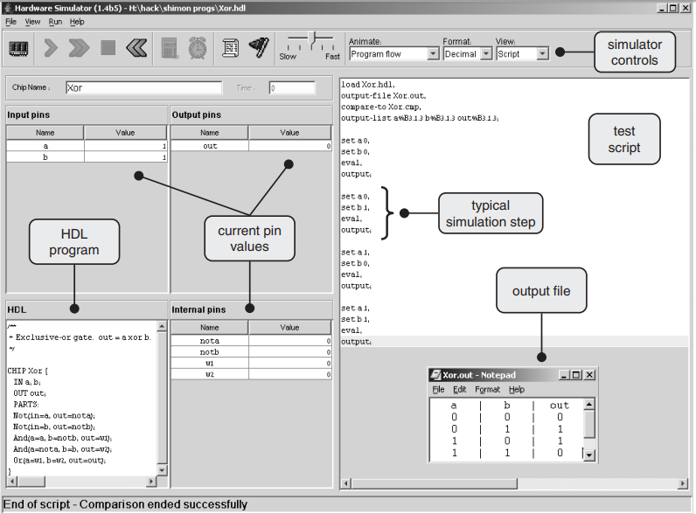
HDL hardware simulator

Slide 65

Primitive gate nand
out = 0
a = 0
b = 0

Slide 66
Primitive gate nand
out = 0
a = 0
b = 0

Slide 67
Primitive gate nand
out = 0
a = 1
b = 0

Slide 68
Primitive gate nand
out = 1
a = 1
b = 1

Slide 69
Primitive gate nand
Nand(a=, b=, out=);
a = 0
out = 0
b = 0

Slide 70
Primitive gate nand
Nand(a=, b=, out=);
a
out
b
NMOS

Slide 71
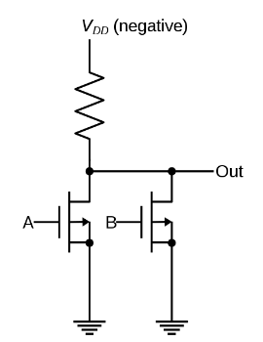
Primitive gate nand
Nand(a=, b=, out=);
a
a
out
or
out
b
b
NMOS
PMOS

Slide 72
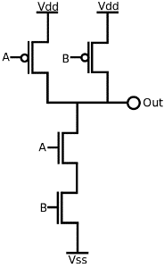
Primitive gate nand
Nand(a=, b=, out=);
a
a
out
or
out
b
b
NMOS
PMOS
or
a
out
b
CMOS

Slide 73
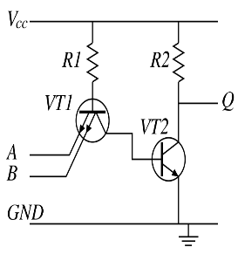
Primitive gate nand
Nand(a=, b=, out=);
a
a
out
or
out
b
b
NMOS
PMOS
or
or
a
a
out
or
out
b
b
CMOS
TTL

Slide 74
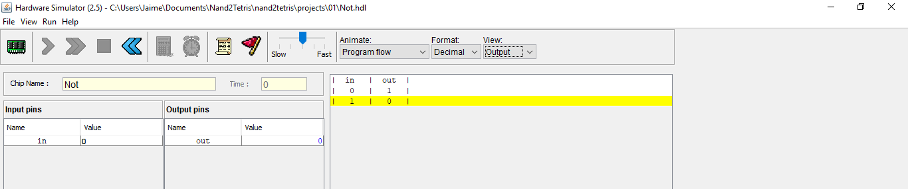
Basic gates not
/**
* Not gate:
* out = not in
*/
CHIP Not {
IN in;
OUT out;
PARTS:
Nand(a=in, b=in, out=out);
}
in
a
in
out
out
out
in
b

Slide 75
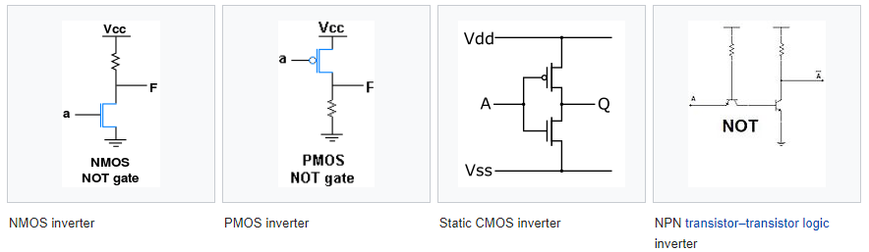
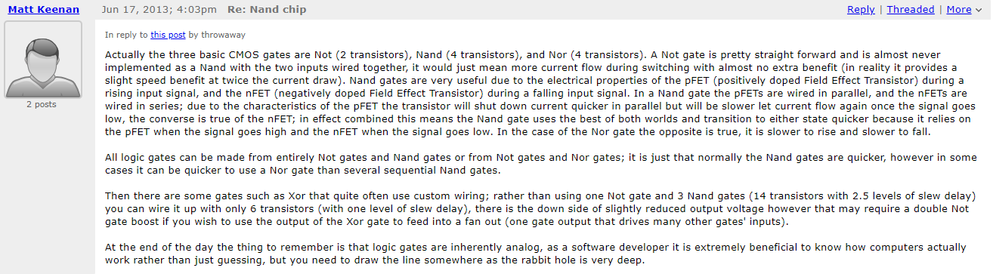
Basic gates not
in
a
in
out
out
out
in
b

Slide 76
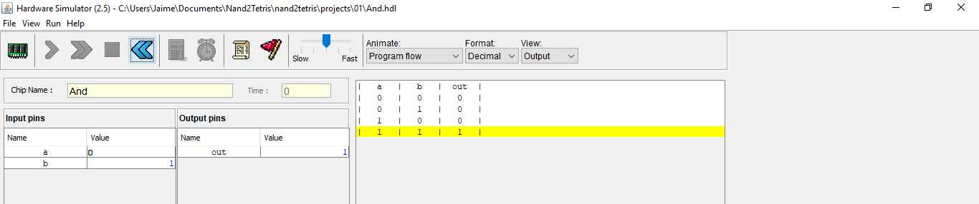
Basic gates and
/**
* And gate:
* out = 1 if (a == 1 and b == 1)
* 0 otherwise
*/
CHIP And {
IN a, b;
OUT out;
PARTS:
Nand(a=a, b=b, out=o1);
Nand(a=o1, b=o1, out=out);
}
a
a
a
o1
a
out
o1
out
out
out
b
b
b
o1
b

Slide 77
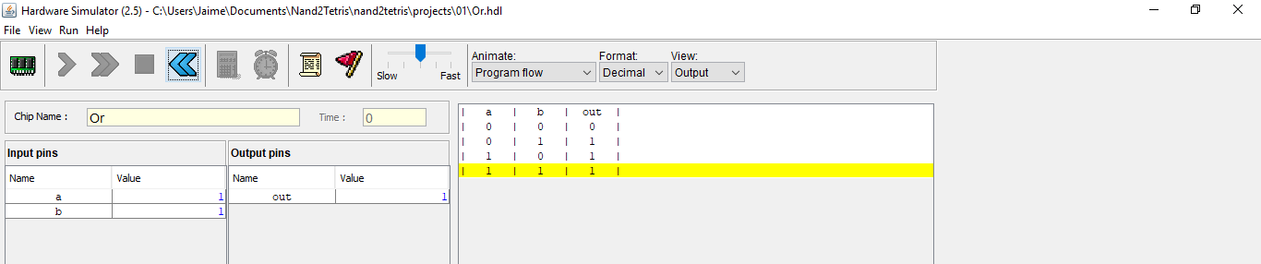
Basic gates or
/**
* Or gate:
* out = 1 if (a == 1 or b == 1)
* 0 otherwise
*/
CHIP Or {
IN a, b;
OUT out;
PARTS:
Nand(a=a, b=a, out=o1);
Nand(a=b, b=b, out=o2);
Nand(a=o1, b=o2, out=out);
}
a
a
a
out
o1
a
b
a
out
out
out
b
b
a
b
out
o2
b
b

Slide 78
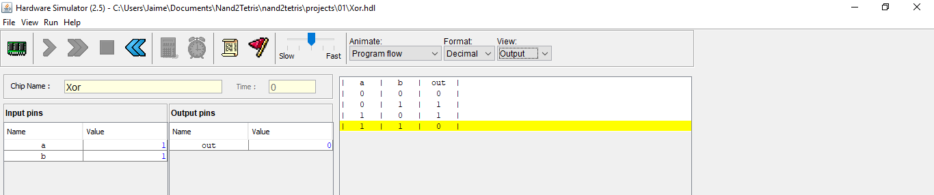
Basic gates xor
/**
* Exclusive-or gate:
* out = not (a == b)
*/
CHIP Xor {
IN a, b;
OUT out;
PARTS:
Not(in=a, out=nota);
Not(in=b, out=notb);
And(a=a, b=notb, out=w1);
And(a=nota, b=b, out=w2);
Or(a=w1, b=w2, out=out);
}
a
a
a
b
w1
b
in out
notb
out
a
b
out
out
a
in out
nota
a
b
b
out
w2
b

Slide 79
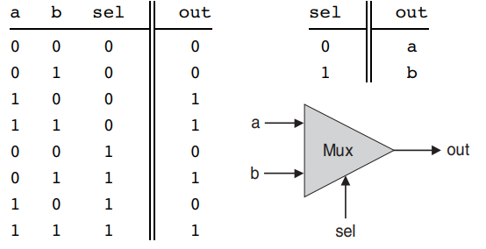
Basic gates multiplexor
/**
* Multiplexor:
* out = a if sel == 0
* b otherwise
*/

Slide 80
Basic gates multiplexor
/**
* Multiplexor:
* out = a if sel == 0
* b otherwise
*/

Slide 81





Basic gates multiplexor
/**
* Multiplexor:
* out = a if sel == 0
* b otherwise
*/
CHIP Mux {
IN a, b, sel;
OUT out;
PARTS:
Not(in=a, out=nota);
Not(in=b, out=notb);
Not(in=sel, out=notsel);
And(a=a, b=notb, out=o1);
And(a=o1, b=notsel, out=o10);
And(a=a, b=b, out=o2);
And(a=o2, b=notsel, out=o20);
And(a=nota, b=b, out=o3);
And(a=o3, b=sel, out=o30);
And(a=a, b=b, out=o4);
And(a=o4, b=sel, out=o40);
Or(a=o10, b=o20, out=o12);
Or(a=o30, b=o40, out=o34);
Or(a=o12, b=o34, out=out);
}
$$a∙\overline{b}∙\overline{sel}$$
a
$$a∙b∙\overline{sel}$$
$$\overline{a}∙b∙sel$$
out
$$a∙b∙sel$$
$$out=a∙\overline{b}∙\overline{sel}+a∙b∙\overline{sel}+\overline{a}∙b∙sel+a∙b∙sel=\left(\overline{b}+\overline{b}\right)∙a∙\overline{sel}+\left(\overline{a}+a\right)∙b∙sel=\left(1\right)∙a∙\overline{sel}+\left(1\right)∙b∙sel$$
b
sel

Slide 82
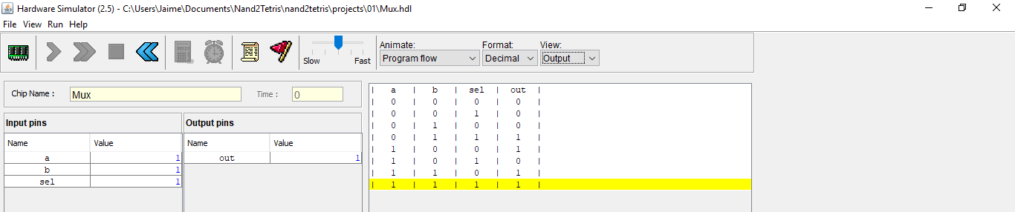
Basic gates multiplexor
/**
* Multiplexor:
* out = a if sel == 0
* b otherwise
*/
CHIP Mux {
IN a, b, sel;
OUT out;
PARTS:
Not(in=a, out=nota);
Not(in=b, out=notb);
Not(in=sel, out=notsel);
And(a=a, b=notb, out=o1);
And(a=o1, b=notsel, out=o10);
And(a=a, b=b, out=o2);
And(a=o2, b=notsel, out=o20);
And(a=nota, b=b, out=o3);
And(a=o3, b=sel, out=o30);
And(a=a, b=b, out=o4);
And(a=o4, b=sel, out=o40);
Or(a=o10, b=o20, out=o12);
Or(a=o30, b=o40, out=o34);
Or(a=o12, b=o34, out=out);
}
$$a∙\overline{b}∙\overline{sel}$$
a
$$a∙b∙\overline{sel}$$
$$\overline{a}∙b∙sel$$
out
$$a∙b∙sel$$
$$out=a∙\overline{b}∙\overline{sel}+a∙b∙\overline{sel}+\overline{a}∙b∙sel+a∙b∙sel=\left(\overline{b}+\overline{b}\right)∙a∙\overline{sel}+\left(\overline{a}+a\right)∙b∙sel=\left(1\right)∙a∙\overline{sel}+\left(1\right)∙b∙sel$$
b
sel

Slide 83

Basic gates multiplexor
/**
* Multiplexor:
* out = a if sel == 0
* b otherwise
*/
CHIP Mux {
IN a, b, sel;
OUT out;
PARTS:
Not(in=a, out=nota);
Not(in=b, out=notb);
Not(in=sel, out=notsel);
And(a=a, b=notb, out=o1);
And(a=o1, b=notsel, out=o10);
And(a=a, b=b, out=o2);
And(a=o2, b=notsel, out=o20);
And(a=nota, b=b, out=o3);
And(a=o3, b=sel, out=o30);
And(a=a, b=b, out=o4);
And(a=o4, b=sel, out=o40);
Or(a=o10, b=o20, out=o12);
Or(a=o30, b=o40, out=o34);
Or(a=o12, b=o34, out=out);
}
$$a∙\overline{b}∙\overline{sel}$$
a
$$a∙b∙\overline{sel}$$
$$\overline{a}∙b∙sel$$
out
$$a∙b∙sel$$
$$out=a∙\overline{b}∙\overline{sel}+a∙b∙\overline{sel}+\overline{a}∙b∙sel+a∙b∙sel=\left(\overline{b}+\overline{b}\right)∙a∙\overline{sel}+\left(\overline{a}+a\right)∙b∙sel=\left(1\right)∙a∙\overline{sel}+\left(1\right)∙b∙sel$$
b
sel

Slide 84

Basic gates multiplexor
/**
* Multiplexor:
* out = a if sel == 0
* b otherwise
*/
CHIP Mux {
IN a, b, sel;
OUT out;
PARTS:
Not(in=a, out=nota);
Not(in=b, out=notb);
Not(in=sel, out=notsel);
And(a=a, b=notb, out=o1);
And(a=o1, b=notsel, out=o10);
And(a=a, b=b, out=o2);
And(a=o2, b=notsel, out=o20);
And(a=nota, b=b, out=o3);
And(a=o3, b=sel, out=o30);
And(a=a, b=b, out=o4);
And(a=o4, b=sel, out=o40);
Or(a=o10, b=o20, out=o12);
Or(a=o30, b=o40, out=o34);
Or(a=o12, b=o34, out=out);
}
$$a∙\overline{b}∙\overline{sel}$$
a
$$a∙b∙\overline{sel}$$
$$\overline{a}∙b∙sel$$
out
$$a∙b∙sel$$
$$out=a∙\overline{b}∙\overline{sel}+a∙b∙\overline{sel}+\overline{a}∙b∙sel+a∙b∙sel=\left(\overline{b}+\overline{b}\right)∙a∙\overline{sel}+\left(\overline{a}+a\right)∙b∙sel=\left(1\right)∙a∙\overline{sel}+\left(1\right)∙b∙sel$$
b
sel

Slide 85

Basic gates multiplexor
/**
* Multiplexor:
* out = a if sel == 0
* b otherwise
*/
CHIP Mux {
IN a, b, sel;
OUT out;
PARTS:
Not(in=sel, out=notsel);
And(a=a, b=notsel, out=o1);
And(a=b, b=sel, out=o2);
Or(a=o1, b=o2, out=out);
}
$$a∙\overline{b}∙\overline{sel}$$
a
$$a∙b∙\overline{sel}$$
$$\overline{a}∙b∙sel$$
out
$$a∙b∙sel$$
$$out=a∙\overline{b}∙\overline{sel}+a∙b∙\overline{sel}+\overline{a}∙b∙sel+a∙b∙sel=\left(\overline{b}+\overline{b}\right)∙a∙\overline{sel}+\left(\overline{a}+a\right)∙b∙sel=\left(1\right)∙a∙\overline{sel}+\left(1\right)∙b∙sel$$
b
$$=a∙\overline{sel}+b∙sel$$
sel

Slide 86
Basic gates multiplexor
/**
* Multiplexor:
* out = a if sel == 0
* b otherwise
*/
CHIP Mux {
IN a, b, sel;
OUT out;
PARTS:
Not(in=sel, out=notsel);
And(a=a, b=notsel, out=o1);
And(a=b, b=sel, out=o2);
Or(a=o1, b=o2, out=out);
}
$$a∙\overline{b}∙\overline{sel}$$
a
$$a∙b∙\overline{sel}$$
$$\overline{a}∙b∙sel$$
a
a
o1
notsel
out
b
a
out
$$a∙b∙sel$$
b
out
out
a
b
sel
out
b
o2
$$out=a∙\overline{b}∙\overline{sel}+a∙b∙\overline{sel}+\overline{a}∙b∙sel+a∙b∙sel=\left(\overline{b}+\overline{b}\right)∙a∙\overline{sel}+\left(\overline{a}+a\right)∙b∙sel=\left(1\right)∙a∙\overline{sel}+\left(1\right)∙b∙sel$$
notsel
out
b
in
sel
$$=a∙\overline{sel}+b∙sel$$
sel

Slide 87
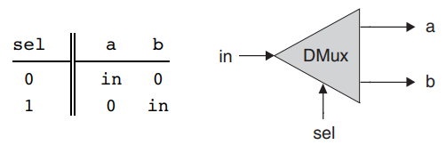
Basic gates demultiplexor
/**
* Demultiplexor:
* {a, b} = {in, 0} if sel == 0
* {0, in} if sel == 1
*/

Slide 88
Basic gates demultiplexor
/**
* Demultiplexor:
* {a, b} = {in, 0} if sel == 0
* {0, in} if sel == 1
*/

Slide 89
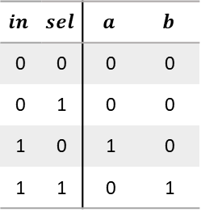
Basic gates demultiplexor
/**
* Demultiplexor:
* {a, b} = {in, 0} if sel == 0
* {0, in} if sel == 1
*/
$$in$$ | $$sel$$ | $$a$$ | $$b$$
0 | 0 | 0 | 0
0 | 1 | 0 | 0
1 | 0 | 1 | 0
1 | 1 | 0 | 1

Slide 90


Basic gates demultiplexor
/**
* Demultiplexor:
* {a, b} = {in, 0} if sel == 0
* {0, in} if sel == 1
*/
CHIP DMux {
IN in, sel;
OUT a, b;
PARTS:
Not(in=sel, out=notsel);
And(a=in, b=notsel, out=a);
And(a=in, b=sel, out=b);
}
a
a
a
a
notsel
out
b
in
b
b
a
sel
out
b
$$in$$ | $$sel$$ | $$a$$ | $$b$$
0 | 0 | 0 | 0
0 | 1 | 0 | 0
1 | 0 | 1 | 0
1 | 1 | 0 | 1
notsel
out
in
b
sel
$$a=in∙\overline{sel}$$
$$b=in∙sel$$
sel

Slide 91
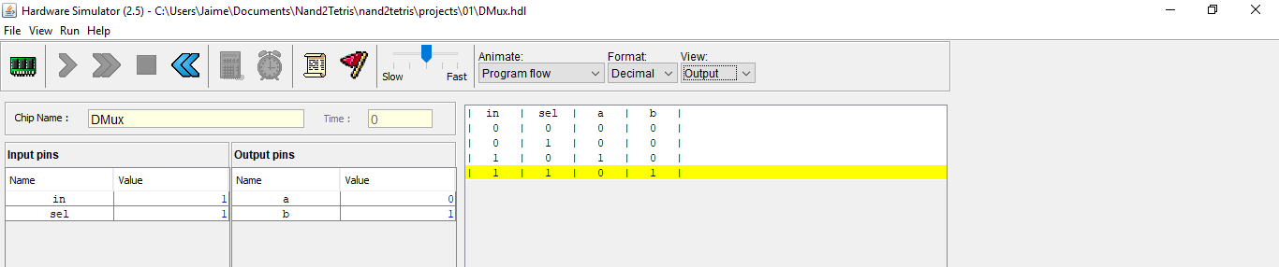
Basic gates demultiplexor
/**
* Demultiplexor:
* {a, b} = {in, 0} if sel == 0
* {0, in} if sel == 1
*/
CHIP DMux {
IN in, sel;
OUT a, b;
PARTS:
Not(in=sel, out=notsel);
And(a=in, b=notsel, out=a);
And(a=in, b=sel, out=b);
}
a
a
a
a
notsel
out
b
in
b
b
a
sel
out
b
$$in$$ | $$sel$$ | $$a$$ | $$b$$
0 | 0 | 0 | 0
0 | 1 | 0 | 0
1 | 0 | 1 | 0
1 | 1 | 0 | 1
notsel
out
in
b
sel
$$a=in∙\overline{sel}$$
$$b=in∙sel$$
sel

Slide 92
Multi-bit gates not16
/**
* 16-bit bitwise Not:
* for i=0..15: out[i] = not in[i]
*/
0001001000110100
Not
1110110111001011

Slide 93
Multi-bit gates not16
/**
* 16-bit bitwise Not:
* for i=0..15: out[i] = not in[i]
*/
CHIP Not16 {
IN in[16];
OUT out[16];
PARTS:
Not(in=in[0], out=out[0]);
Not(in=in[1], out=out[1]);
Not(in=in[2], out=out[2]);
Not(in=in[3], out=out[3]);
Not(in=in[4], out=out[4]);
Not(in=in[5], out=out[5]);
Not(in=in[6], out=out[6]);
Not(in=in[7], out=out[7]);
Not(in=in[8], out=out[8]);
Not(in=in[9], out=out[9]);
Not(in=in[10], out=out[10]);
Not(in=in[11], out=out[11]);
Not(in=in[12], out=out[12]);
Not(in=in[13], out=out[13]);
Not(in=in[14], out=out[14]);
Not(in=in[15], out=out[15]);
}
in[0] = 0 out[0] = 1
in[0] = 0 out[0] = 1
in[1] = 0 out[1] = 1
in[1] = 0 out[1] = 1
in[2] = 0 out[2] = 1
in[2] = 0 out[2] = 1
in[3] = 1 out[3] = 0
in[3] = 1 out[3] = 0
in[4] = 0 out[4] = 1
in[4] = 0 out[4] = 1
in[5] = 0 out[5] = 1
in[5] = 0 out[5] = 1
in[6] = 1 out[6] = 0
in[6] = 1 out[6] = 0
in[7] = 0 out[7] = 1
in[7] = 0 out[7] = 1
in[8] = 0 out[8] = 1
in[8] = 0 out[8] = 1
in[9] = 0 out[9] = 1
in[9] = 0 out[9] = 1
in[10] = 1 out[10] = 0
in[10] = 1 out[10] = 0
in[11] = 1 out[11] = 0
in[11] = 1 out[11] = 0
in[12] = 0 out[12] = 1
in[12] = 0 out[12] = 1
in[13] = 1 out[13] = 0
in[13] = 1 out[13] = 0
in[14] = 0 out[14] = 1
in[14] = 0 out[14] = 1
in[15] = 0 out[15] = 1
in[15] = 0 out[15] = 1

Slide 94
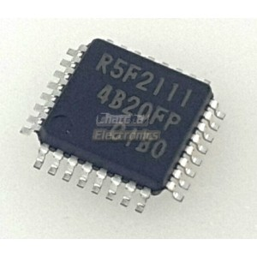
Multi-bit gates not16
/**
* 16-bit bitwise Not:
* for i=0..15: out[i] = not in[i]
*/
CHIP Not16 {
IN in[16];
OUT out[16];
PARTS:
Not(in=in[0], out=out[0]);
Not(in=in[1], out=out[1]);
Not(in=in[2], out=out[2]);
Not(in=in[3], out=out[3]);
Not(in=in[4], out=out[4]);
Not(in=in[5], out=out[5]);
Not(in=in[6], out=out[6]);
Not(in=in[7], out=out[7]);
Not(in=in[8], out=out[8]);
Not(in=in[9], out=out[9]);
Not(in=in[10], out=out[10]);
Not(in=in[11], out=out[11]);
Not(in=in[12], out=out[12]);
Not(in=in[13], out=out[13]);
Not(in=in[14], out=out[14]);
Not(in=in[15], out=out[15]);
}
in[0] = 0 out[0] = 1
in[0] = 0 out[0] = 1
in[1] = 0 out[1] = 1
in[1] = 0 out[1] = 1
in[2] = 0 out[2] = 1
in[2] = 0 out[2] = 1
in[3] = 1 out[3] = 0
in[3] = 1 out[3] = 0
in[4] = 0 out[4] = 1
in[4] = 0 out[4] = 1
in[5] = 0 out[5] = 1
in[5] = 0 out[5] = 1
in[6] = 1 out[6] = 0
in[6] = 1 out[6] = 0
in[7] = 0 out[7] = 1
in[7] = 0 out[7] = 1
in[8] = 0 out[8] = 1
in[8] = 0 out[8] = 1
in[9] = 0 out[9] = 1
in[9] = 0 out[9] = 1
in[10] = 1 out[10] = 0
in[10] = 1 out[10] = 0
in[11] = 1 out[11] = 0
in[11] = 1 out[11] = 0
in[12] = 0 out[12] = 1
in[12] = 0 out[12] = 1
in[13] = 1 out[13] = 0
in[13] = 1 out[13] = 0
in[14] = 0 out[14] = 1
in[14] = 0 out[14] = 1
in[15] = 0 out[15] = 1
in[15] = 0 out[15] = 1

Slide 95
Multi-bit gates not16
/**
* 16-bit bitwise Not:
* for i=0..15: out[i] = not in[i]
*/
CHIP Not16 {
IN in[16];
OUT out[16];
PARTS:
Not(in=in[0], out=out[0]);
Not(in=in[1], out=out[1]);
Not(in=in[2], out=out[2]);
Not(in=in[3], out=out[3]);
Not(in=in[4], out=out[4]);
Not(in=in[5], out=out[5]);
Not(in=in[6], out=out[6]);
Not(in=in[7], out=out[7]);
Not(in=in[8], out=out[8]);
Not(in=in[9], out=out[9]);
Not(in=in[10], out=out[10]);
Not(in=in[11], out=out[11]);
Not(in=in[12], out=out[12]);
Not(in=in[13], out=out[13]);
Not(in=in[14], out=out[14]);
Not(in=in[15], out=out[15]);
}
in[0] = 0 out[0] = 1
in[1] = 0 out[1] = 1
in[2] = 0 out[2] = 1
in[3] = 1 out[3] = 0
in[4] = 0 out[4] = 1
in[5] = 0 out[5] = 1
in[6] = 1 out[6] = 0
in[] = 0001001000110100 1110110111001011 = out[]
in[7] = 0 out[7] = 1
16
in[8] = 0 out[8] = 1
16
in[9] = 0 out[9] = 1
in[10] = 1 out[10] = 0
in[11] = 1 out[11] = 0
in[12] = 0 out[12] = 1
in[13] = 1 out[13] = 0
in[14] = 0 out[14] = 1
in[15] = 0 out[15] = 1

Slide 96
Multi-bit gates not16
/**
* 16-bit bitwise Not:
* for i=0..15: out[i] = not in[i]
*/
CHIP Not16 {
IN in[16];
OUT out[16];
PARTS:
Not(in=in[0], out=out[0]);
Not(in=in[1], out=out[1]);
Not(in=in[2], out=out[2]);
Not(in=in[3], out=out[3]);
Not(in=in[4], out=out[4]);
Not(in=in[5], out=out[5]);
Not(in=in[6], out=out[6]);
Not(in=in[7], out=out[7]);
Not(in=in[8], out=out[8]);
Not(in=in[9], out=out[9]);
Not(in=in[10], out=out[10]);
Not(in=in[11], out=out[11]);
Not(in=in[12], out=out[12]);
Not(in=in[13], out=out[13]);
Not(in=in[14], out=out[14]);
Not(in=in[15], out=out[15]);
}
in[0] = 0 out[0] = 1
in[1] = 0 out[1] = 1
in[2] = 0 out[2] = 1
in[3] = 1 out[3] = 0
in[4] = 0 out[4] = 1
in[5] = 0 out[5] = 1
in[6] = 1 out[6] = 0
in[] = 0001001000110100 1110110111001011 = out[]
in[7] = 0 out[7] = 1
16
in[8] = 0 out[8] = 1
16
in[9] = 0 out[9] = 1
in[10] = 1 out[10] = 0
in[11] = 1 out[11] = 0
in[12] = 0 out[12] = 1
in[13] = 1 out[13] = 0
in[14] = 0 out[14] = 1
in[15] = 0 out[15] = 1

Slide 97
Multi-bit gates not16
/**
* 16-bit bitwise Not:
* for i=0..15: out[i] = not in[i]
*/
CHIP Not16 {
IN in[16];
OUT out[16];
PARTS:
Not(in=in[0], out=out[0]);
Not(in=in[1], out=out[1]);
Not(in=in[2], out=out[2]);
Not(in=in[3], out=out[3]);
Not(in=in[4], out=out[4]);
Not(in=in[5], out=out[5]);
Not(in=in[6], out=out[6]);
Not(in=in[7], out=out[7]);
Not(in=in[8], out=out[8]);
Not(in=in[9], out=out[9]);
Not(in=in[10], out=out[10]);
Not(in=in[11], out=out[11]);
Not(in=in[12], out=out[12]);
Not(in=in[13], out=out[13]);
Not(in=in[14], out=out[14]);
Not(in=in[15], out=out[15]);
}
in[0] = 0 out[0] = 1
in[1] = 0 out[1] = 1
in[2] = 0 out[2] = 1
in[3] = 1 out[3] = 0
in[4] = 0 out[4] = 1
in[5] = 0 out[5] = 1
in[6] = 1 out[6] = 0
in[] = 0001001000110100 1110110111001011 = out[]
in[7] = 0 out[7] = 1
16
in[8] = 0 out[8] = 1
16
in[9] = 0 out[9] = 1
in[10] = 1 out[10] = 0
in[11] = 1 out[11] = 0
in[12] = 0 out[12] = 1
in[13] = 1 out[13] = 0
in[14] = 0 out[14] = 1
in[15] = 0 out[15] = 1

Slide 98
Multi-bit gates not16
/**
* 16-bit bitwise Not:
* for i=0..15: out[i] = not in[i]
*/
CHIP Not16 {
IN in[16];
OUT out[16];
PARTS:
Not(in=in[0], out=out[0]);
Not(in=in[1], out=out[1]);
Not(in=in[2], out=out[2]);
Not(in=in[3], out=out[3]);
Not(in=in[4], out=out[4]);
Not(in=in[5], out=out[5]);
Not(in=in[6], out=out[6]);
Not(in=in[7], out=out[7]);
Not(in=in[8], out=out[8]);
Not(in=in[9], out=out[9]);
Not(in=in[10], out=out[10]);
Not(in=in[11], out=out[11]);
Not(in=in[12], out=out[12]);
Not(in=in[13], out=out[13]);
Not(in=in[14], out=out[14]);
Not(in=in[15], out=out[15]);
}
in[0] = 0 out[0] = 1
in[1] = 0 out[1] = 1
in[2] = 0 out[2] = 1
in[3] = 1 out[3] = 0
in[4] = 0 out[4] = 1
in[5] = 0 out[5] = 1
in[6] = 1 out[6] = 0
in[] = 0001001000110100 1110110111001011 = out[]
in[7] = 0 out[7] = 1
16
in[8] = 0 out[8] = 1
16
in[9] = 0 out[9] = 1
in[10] = 1 out[10] = 0
in[11] = 1 out[11] = 0
in[12] = 0 out[12] = 1
in[13] = 1 out[13] = 0
in[14] = 0 out[14] = 1
in[15] = 0 out[15] = 1

Slide 99
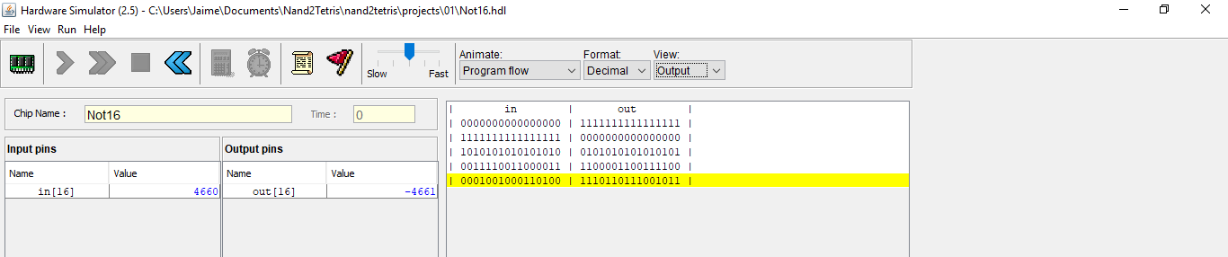
Multi-bit gates not16
/**
* 16-bit bitwise Not:
* for i=0..15: out[i] = not in[i]
*/
CHIP Not16 {
IN in[16];
OUT out[16];
PARTS:
Not(in=in[0], out=out[0]);
Not(in=in[1], out=out[1]);
Not(in=in[2], out=out[2]);
Not(in=in[3], out=out[3]);
Not(in=in[4], out=out[4]);
Not(in=in[5], out=out[5]);
Not(in=in[6], out=out[6]);
Not(in=in[7], out=out[7]);
Not(in=in[8], out=out[8]);
Not(in=in[9], out=out[9]);
Not(in=in[10], out=out[10]);
Not(in=in[11], out=out[11]);
Not(in=in[12], out=out[12]);
Not(in=in[13], out=out[13]);
Not(in=in[14], out=out[14]);
Not(in=in[15], out=out[15]);
}
in[0] = 0 out[0] = 1
in[1] = 0 out[1] = 1
in[2] = 0 out[2] = 1
in[3] = 1 out[3] = 0
in[4] = 0 out[4] = 1
in[5] = 0 out[5] = 1
in[6] = 1 out[6] = 0
in[] = 0001001000110100 1110110111001011 = out[]
in[7] = 0 out[7] = 1
16
in[8] = 0 out[8] = 1
16
in[9] = 0 out[9] = 1
in[10] = 1 out[10] = 0
in[11] = 1 out[11] = 0
in[12] = 0 out[12] = 1
in[13] = 1 out[13] = 0
in[14] = 0 out[14] = 1
in[15] = 0 out[15] = 1

Slide 100
Multi-bit gates and16
/**
* 16-bit bitwise And:
* for i = 0..15: out[i] = (a[i] and b[i])
*/
0001001000110100
1001100001110110
Not
0001000000110100

Slide 101
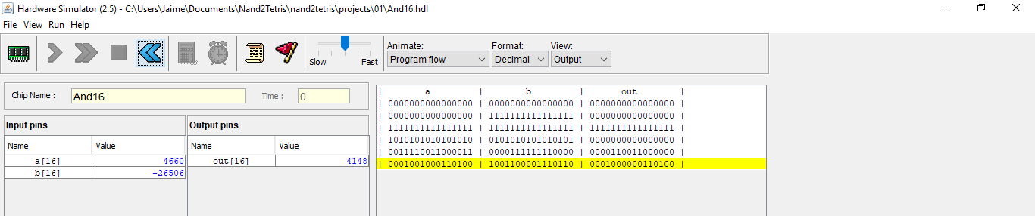
Multi-bit gates and16
/**
* 16-bit bitwise And:
* for i = 0..15: out[i] = (a[i] and b[i])
*/
CHIP And16 {
IN a[16], b[16];
OUT out[16];
PARTS:
And(a=a[0], b=b[0], out=out[0]);
And(a=a[1], b=b[1], out=out[1]);
And(a=a[2], b=b[2], out=out[2]);
And(a=a[3], b=b[3], out=out[3]);
And(a=a[4], b=b[4], out=out[4]);
And(a=a[5], b=b[5], out=out[5]);
And(a=a[6], b=b[6], out=out[6]);
And(a=a[7], b=b[7], out=out[7]);
And(a=a[8], b=b[8], out=out[8]);
And(a=a[9], b=b[9], out=out[9]);
And(a=a[10], b=b[10], out=out[10]);
And(a=a[11], b=b[11], out=out[11]);
And(a=a[12], b=b[12], out=out[12]);
And(a=a[13], b=b[13], out=out[13]);
And(a=a[14], b=b[14], out=out[14]);
And(a=a[15], b=b[15], out=out[15]);
}
a[0] = 0 out[0] = 0
b[0] = 1
a[1] = 0 out[1] = 0
b[1] = 0
a[2] = 0 out[2] = 0
b[2] = 0
a[3] = 1 out[3] = 1
b[3] = 1
a[] = 0001001000110100
a[4] = 0 out[4] = 0
16
b[4] = 1
a[5] = 0 out[5] = 0
b[5] = 0
a[6] = 1 out[6] = 0
b[6] = 0
in[] = 0001001000110100 0001000000110100 = out[]
a[7] = 0 out[7] = 0
b[7] = 0
a[8] = 0 out[8] = 0
16
b[8] = 0
a[9] = 0 out[9] = 0
b[9] = 1
a[10] = 1 out[10] = 1
b[] = 1001100001110110
b[10] = 1
16
a[11] = 1 out[11] = 1
b[11] = 1
a[12] = 0 out[12] = 0
b[12] = 0
a[13] = 1 out[13] = 1
b[13] = 1
a[14] = 0 out[14] = 0
b[14] = 1
a[15] = 0 out[15] = 0
b[15] = 0

Slide 102
Multi-bit gates and16
/**
* 16-bit bitwise And:
* for i = 0..15: out[i] = (a[i] and b[i])
*/
CHIP And16 {
IN a[16], b[16];
OUT out[16];
PARTS:
And(a=a[0], b=b[0], out=out[0]);
And(a=a[1], b=b[1], out=out[1]);
And(a=a[2], b=b[2], out=out[2]);
And(a=a[3], b=b[3], out=out[3]);
And(a=a[4], b=b[4], out=out[4]);
And(a=a[5], b=b[5], out=out[5]);
And(a=a[6], b=b[6], out=out[6]);
And(a=a[7], b=b[7], out=out[7]);
And(a=a[8], b=b[8], out=out[8]);
And(a=a[9], b=b[9], out=out[9]);
And(a=a[10], b=b[10], out=out[10]);
And(a=a[11], b=b[11], out=out[11]);
And(a=a[12], b=b[12], out=out[12]);
And(a=a[13], b=b[13], out=out[13]);
And(a=a[14], b=b[14], out=out[14]);
And(a=a[15], b=b[15], out=out[15]);
}
a[0] = 0 out[0] = 0
b[0] = 1
a[1] = 0 out[1] = 0
b[1] = 0
a[2] = 0 out[2] = 0
b[2] = 0
a[3] = 1 out[3] = 1
b[3] = 1
a[] = 0001001000110100
a[4] = 0 out[4] = 0
16
b[4] = 1
a[5] = 0 out[5] = 0
b[5] = 0
a[6] = 1 out[6] = 0
b[6] = 0
in[] = 0001001000110100 0001000000110100 = out[]
a[7] = 0 out[7] = 0
b[7] = 0
a[8] = 0 out[8] = 0
16
b[8] = 0
a[9] = 0 out[9] = 0
b[9] = 1
a[10] = 1 out[10] = 1
b[] = 1001100001110110
b[10] = 1
16
a[11] = 1 out[11] = 1
b[11] = 1
a[12] = 0 out[12] = 0
b[12] = 0
a[13] = 1 out[13] = 1
b[13] = 1
a[14] = 0 out[14] = 0
b[14] = 1
a[15] = 0 out[15] = 0
b[15] = 0

Slide 103
Multi-bit gates or16
/**
* 16-bit bitwise Or:
* for i = 0..15 out[i] = (a[i] or b[i])
*/
0001001000110100
1001100001110110
Not
1001101001110110

Slide 104
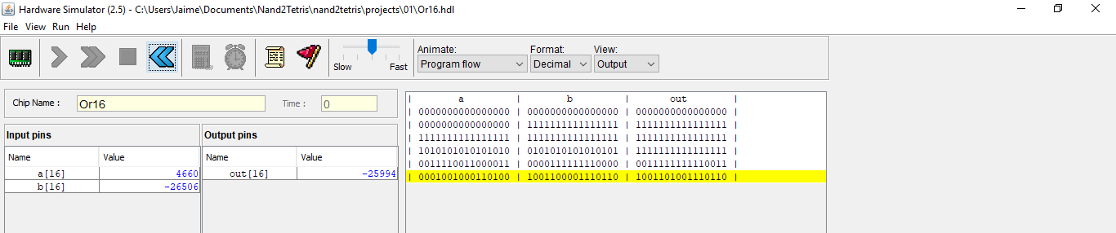
Multi-bit gates or16
/**
* 16-bit bitwise Or:
* for i = 0..15 out[i] = (a[i] or b[i])
*/
CHIP Or16 {
IN a[16], b[16];
OUT out[16];
PARTS:
Or(a=a[0], b=b[0], out=out[0]);
Or(a=a[1], b=b[1], out=out[1]);
Or(a=a[2], b=b[2], out=out[2]);
Or(a=a[3], b=b[3], out=out[3]);
Or(a=a[4], b=b[4], out=out[4]);
Or(a=a[5], b=b[5], out=out[5]);
Or(a=a[6], b=b[6], out=out[6]);
Or(a=a[7], b=b[7], out=out[7]);
Or(a=a[8], b=b[8], out=out[8]);
Or(a=a[9], b=b[9], out=out[9]);
Or(a=a[10], b=b[10], out=out[10]);
Or(a=a[11], b=b[11], out=out[11]);
Or(a=a[12], b=b[12], out=out[12]);
Or(a=a[13], b=b[13], out=out[13]);
Or(a=a[14], b=b[14], out=out[14]);
Or(a=a[15], b=b[15], out=out[15]);
}
a[0] = 0 out[0] = 1
b[0] = 1
a[1] = 0 out[1] = 0
b[1] = 0
a[2] = 0 out[2] = 0
b[2] = 0
a[3] = 1 out[3] = 1
b[3] = 1
a[] = 0001001000110100
a[4] = 0 out[4] = 1
16
b[4] = 1
a[5] = 0 out[5] = 0
b[5] = 0
a[6] = 1 out[6] = 1
b[6] = 0
in[] = 0001001000110100 1001101001110110 = out[]
a[7] = 0 out[7] = 0
b[7] = 0
a[8] = 0 out[8] = 0
16
b[8] = 0
a[9] = 0 out[9] = 1
b[9] = 1
a[10] = 1 out[10] = 1
b[] = 1001100001110110
b[10] = 1
16
a[11] = 1 out[11] = 1
b[11] = 1
a[12] = 0 out[12] = 0
b[12] = 0
a[13] = 1 out[13] = 1
b[13] = 1
a[14] = 0 out[14] = 1
b[14] = 1
a[15] = 0 out[15] = 0
b[15] = 0

Slide 105
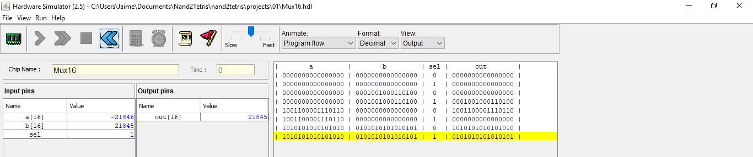
Multi-bit gates mux16
/**
* 16-bit multiplexor:
* for i = 0..15 out[i] = a[i] if sel == 0
* b[i] if sel == 1
*/
CHIP Mux16 {
IN a[16], b[16], sel;
OUT out[16];
PARTS:
Mux(a=a[0], b=b[0], sel=sel, out=out[0]);
Mux(a=a[1], b=b[1], sel=sel, out=out[1]);
Mux(a=a[2], b=b[2], sel=sel, out=out[2]);
Mux(a=a[3], b=b[3], sel=sel, out=out[3]);
Mux(a=a[4], b=b[4], sel=sel, out=out[4]);
Mux(a=a[5], b=b[5], sel=sel, out=out[5]);
Mux(a=a[6], b=b[6], sel=sel, out=out[6]);
Mux(a=a[7], b=b[7], sel=sel, out=out[7]);
Mux(a=a[8], b=b[8], sel=sel, out=out[8]);
Mux(a=a[9], b=b[9], sel=sel, out=out[9]);
Mux(a=a[10], b=b[10], sel=sel, out=out[10]);
Mux(a=a[11], b=b[11], sel=sel, out=out[11]);
Mux(a=a[12], b=b[12], sel=sel, out=out[12]);
Mux(a=a[13], b=b[13], sel=sel, out=out[13]);
Mux(a=a[14], b=b[14], sel=sel, out=out[14]);
Mux(a=a[15], b=b[15], sel=sel, out=out[15]);
}
a[0] = 1 out[0] = 0
b[0] = 0
a[1] = 0 out[1] = 1
b[1] = 1
a[2] = 1 out[2] = 0
b[2] = 0
a[3] = 0 out[3] = 1
b[3] = 1
a[] = 1010101010101010
a[4] = 1 out[4] = 0
16
b[4] = 0
a[5] = 0 out[5] = 1
b[5] = 1
a[6] = 1 out[6] = 0
sel = 1
b[6] = 0
in[] = 0001001000110100 0101010101010101 = out[]
a[7] = 0 out[7] = 1
b[7] = 1
a[8] = 1 out[8] = 0
16
b[8] = 0
a[9] = 0 out[9] = 1
b[9] = 1
a[10] = 1 out[10] = 0
b[] = 0101010101010101
b[10] = 0
16
a[11] = 0 out[11] = 1
b[11] = 1
a[12] = 1 out[12] = 0
b[12] = 0
a[13] = 0 out[13] = 1
b[13] = 1
a[14] = 1 out[14] = 0
b[14] = 0
a[15] = 0 out[15] = 1
b[15] = 1
sel = 1

Slide 106
Multi-way gates or8way
/**
* 2-way Or:
* out = (in[0] or in[1] or ... or in[7])
*/
a
out
b

Slide 107
Multi-way gates or8way
/**
* 8-way Or:
* out = (in[0] or in[1] or ... or in[7])
*/
a
b
c
d
out
e
f
g
h

Slide 108
Multi-way gates or8way
/**
* 8-way Or:
* out = (in[0] or in[1] or ... or in[7])
*/
int[0]
int[1]
int[2]
int[3]
out
int[4]
int[5]
int[6]
int[7]

Slide 109
Multi-way gates or8way
/**
* 8-way Or:
* out = (in[0] or in[1] or ... or in[7])
*/
int[]
out
8

Slide 110
Multi-way gates or8way
/**
* 8-way Or:
* out = (in[0] or in[1] or ... or in[7])
*/
int[] = 00100110
out = 1
8

Slide 111
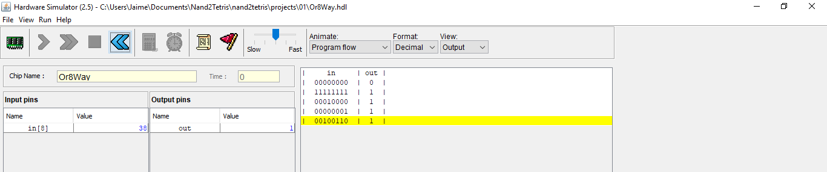
Multi-way gates or8way
/**
* 8-way Or:
* out = (in[0] or in[1] or ... or in[7])
*/
CHIP Or8Way {
IN in[8];
OUT out;
PARTS:
Or(a=in[0], b=in[1], out=o01);
Or(a=in[2], b=in[3], out=o23);
Or(a=in[4], b=in[5], out=o45);
Or(a=in[6], b=in[7], out=o67);
Or(a=o01, b=o23, out=o03);
Or(a=o45, b=o67, out=o47);
Or(a=o03, b=o47, out=out);
}
in[0] = 0
o01 = 0
in[1] = 0
o47 = 1
in[2] = 1
int[] = 00100110
in[3] = 0
o23 = 1
out = 1
out = 1
8
in[4] = 0
o45 = 1
in[5] = 1
o47 = 1
in[6] = 1
in[7] = 0
o67 = 1

Slide 112
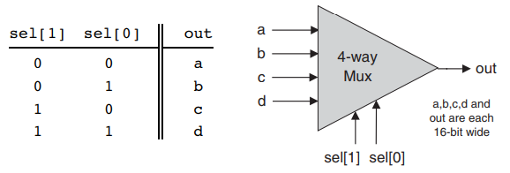
Multi-way and multi-bit gates mux4way16
/**
* 4-way 16-bit multiplexor:
* out = a if sel == 00
* b if sel == 01
* c if sel == 10
* d if sel == 11
*/

Slide 113
Multi-way and multi-bit gates mux4way16
/**
* 4-way 16-bit multiplexor:
* out = a if sel == 00
* b if sel == 01
* c if sel == 10
* d if sel == 11
*/

Slide 114
Multi-way and multi-bit gates mux4way16
/**
* 4-way 16-bit multiplexor:
* out = a if sel == 00
* b if sel == 01
* c if sel == 10
* d if sel == 11
*/
CHIP Mux4Way16 {
IN a[16], b[16], c[16], d[16], sel[2];
OUT out[16];
PARTS:
Mux16(a=a, b=b, sel=sel[0], out=outab);
Mux16(a=c, b=d, sel=sel[0], out=outcd);
Mux16(a=outab, b=outcd, sel=sel[1], out=out);
}
a
16
b
16
out = d
c
16
d
16
sel[0] = 1
sel[1] = 1

Slide 115
Multi-way and multi-bit gates mux4way16
/**
* 4-way 16-bit multiplexor:
* out = a if sel == 00
* b if sel == 01
* c if sel == 10
* d if sel == 11
*/
CHIP Mux4Way16 {
IN a[16], b[16], c[16], d[16], sel[2];
OUT out[16];
PARTS:
Mux16(a=a, b=b, sel=sel[0], out=outab);
Mux16(a=c, b=d, sel=sel[0], out=outcd);
Mux16(a=outab, b=outcd, sel=sel[1], out=out);
}
a
16
b
16
out = d
c
16
d
16
sel[0] = 1
sel[1] = 1

Slide 116
Multi-way and multi-bit gates mux4way16
/**
* 4-way 16-bit multiplexor:
* out = a if sel == 00
* b if sel == 01
* c if sel == 10
* d if sel == 11
*/
CHIP Mux4Way16 {
IN a[16], b[16], c[16], d[16], sel[2];
OUT out[16];
PARTS:
Mux16(a=a, b=b, sel=sel[0], out=outab);
Mux16(a=c, b=d, sel=sel[0], out=outcd);
Mux16(a=outab, b=outcd, sel=sel[1], out=out);
}
a
16
b
16
out = d
c
16
d
16
sel[0] = 1
sel[1] = 1

Slide 117
Multi-way and multi-bit gates mux4way16
/**
* 4-way 16-bit multiplexor:
* out = a if sel == 00
* b if sel == 01
* c if sel == 10
* d if sel == 11
*/
CHIP Mux4Way16 {
IN a[16], b[16], c[16], d[16], sel[2];
OUT out[16];
PARTS:
Mux16(a=a, b=b, sel=sel[0], out=outab);
Mux16(a=c, b=d, sel=sel[0], out=outcd);
Mux16(a=outab, b=outcd, sel=sel[1], out=out);
}
a
16
b
16
out = d
c
16
d
16
sel[0] = 1
sel[1] = 1

Slide 118
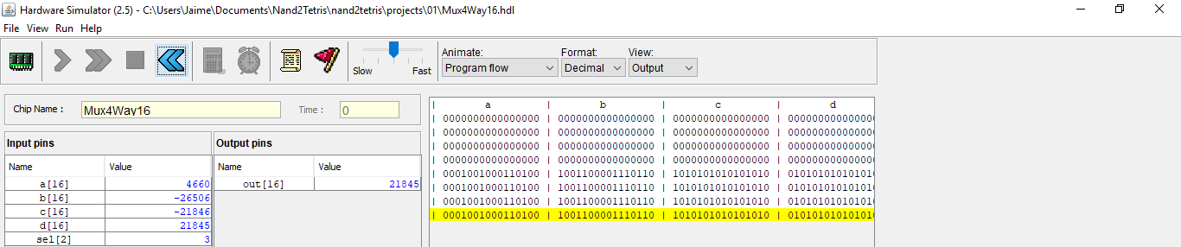
Multi-way and multi-bit gates mux4way16
/**
* 4-way 16-bit multiplexor:
* out = a if sel == 00
* b if sel == 01
* c if sel == 10
* d if sel == 11
*/
CHIP Mux4Way16 {
IN a[16], b[16], c[16], d[16], sel[2];
OUT out[16];
PARTS:
Mux16(a=a, b=b, sel=sel[0], out=outab);
Mux16(a=c, b=d, sel=sel[0], out=outcd);
Mux16(a=outab, b=outcd, sel=sel[1], out=out);
}
a
16
b
b
16
d
out = d
c
16
d
d
16
sel[0] = 1
sel[1] = 1

Slide 119
Multi-way and multi-bit gates mux8way16
/**
* 8-way 16-bit multiplexor:
* out = a if sel == 000
* b if sel == 001
* etc.
* h if sel == 111
*/

Slide 120
Multi-way and multi-bit gates mux8way16
/**
* 8-way 16-bit multiplexor:
* out = a if sel == 000
* b if sel == 001
* etc.
* h if sel == 111
*/
CHIP Mux8Way16 {
IN a[16], b[16], c[16], d[16],
e[16], f[16], g[16], h[16],
sel[3];
OUT out[16];
PARTS:
Mux4Way16(a=a, b=b, c=c, d=d, sel=sel[0..1], out=outad);
Mux4Way16(a=e, b=f, c=g, d=h, sel=sel[0..1], out=outeh);
Mux16(a=outad, b=outeh, sel=sel[2], out=out);
}
a
16
b
16
c
16
d
16
out = h
e
16
16
f
16
g
16
h
2
sel[2] = 1
16
sel[0..1] = [1,1]

Slide 121
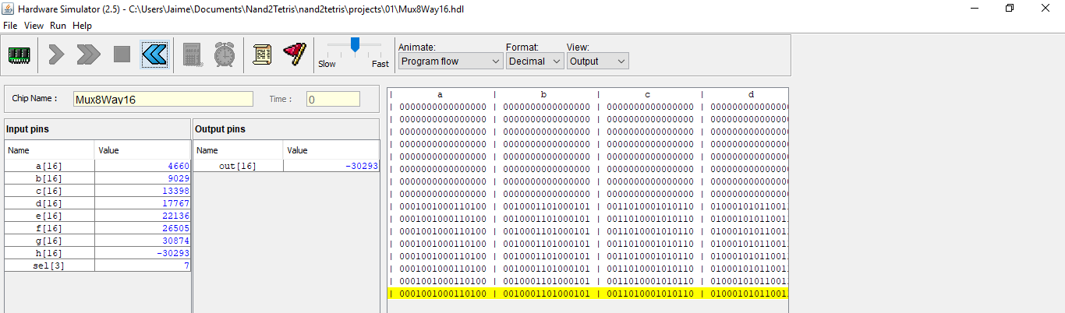
Multi-way and multi-bit gates mux8way16
/**
* 8-way 16-bit multiplexor:
* out = a if sel == 000
* b if sel == 001
* etc.
* h if sel == 111
*/
CHIP Mux8Way16 {
IN a[16], b[16], c[16], d[16],
e[16], f[16], g[16], h[16],
sel[3];
OUT out[16];
PARTS:
Mux4Way16(a=a, b=b, c=c, d=d, sel=sel[0..1], out=outad);
Mux4Way16(a=e, b=f, c=g, d=h, sel=sel[0..1], out=outeh);
Mux16(a=outad, b=outeh, sel=sel[2], out=out);
}
a
16
b
d
16
c
16
d
h
16
out = h
e
16
16
f
h
16
g
16
h
2
sel[2] = 1
16
sel[0..1] = [1,1]

Slide 122
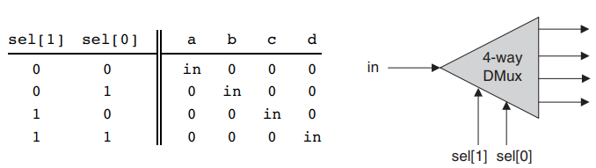
Multi-way and multi-bit gates dmux4way
/**
* 4-way demultiplexor:
* {a, b, c, d} = {in, 0, 0, 0} if sel == 00
* {0, in, 0, 0} if sel == 01
* {0, 0, in, 0} if sel == 10
* {0, 0, 0, in} if sel == 11
*/

Slide 123
Multi-way and multi-bit gates dmux4way
/**
* 4-way demultiplexor:
* {a, b, c, d} = {in, 0, 0, 0} if sel == 00
* {0, in, 0, 0} if sel == 01
* {0, 0, in, 0} if sel == 10
* {0, 0, 0, in} if sel == 11
*/
CHIP DMux4Way {
IN in, sel[2];
OUT a, b, c, d;
PARTS:
DMux(in=in, sel=sel[1], a=outab, b=outcd);
DMux(in=outab, sel=sel[0], a=a, b=b);
DMux(in=outcd, sel=sel[0], a=c, b=d);
}
a
b
in = 1
c
d
2
sel = [1,1]

Slide 124
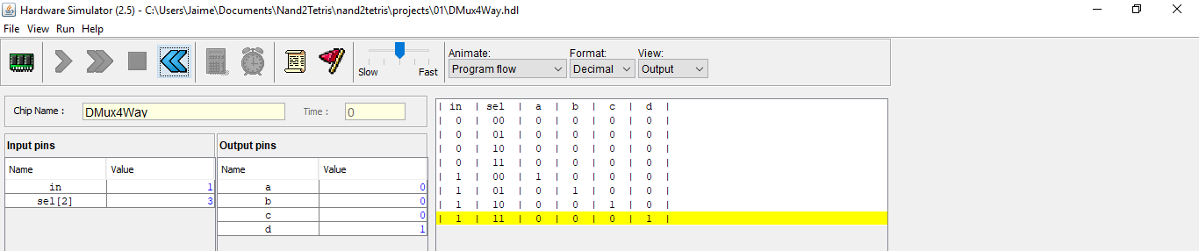
Multi-way and multi-bit gates dmux4way
/**
* 4-way demultiplexor:
* {a, b, c, d} = {in, 0, 0, 0} if sel == 00
* {0, in, 0, 0} if sel == 01
* {0, 0, in, 0} if sel == 10
* {0, 0, 0, in} if sel == 11
*/
CHIP DMux4Way {
IN in, sel[2];
OUT a, b, c, d;
PARTS:
DMux(in=in, sel=sel[1], a=outab, b=outcd);
DMux(in=outab, sel=sel[0], a=a, b=b);
DMux(in=outcd, sel=sel[0], a=c, b=d);
}
a = 0
outab = 0
b = 0
in = 1
outcd = 1
c = 0
d = 1
2
sel = [1,1]

Slide 125
Multi-way and multi-bit gates dmux8way
/**
* 8-way demultiplexor:
* {a, b, c, d, e, f, g, h} = {in, 0, 0, 0, 0, 0, 0, 0} if sel == 000
* {0, in, 0, 0, 0, 0, 0, 0} if sel == 001
* etc.
* {0, 0, 0, 0, 0, 0, 0, in} if sel == 111
*/

Slide 126
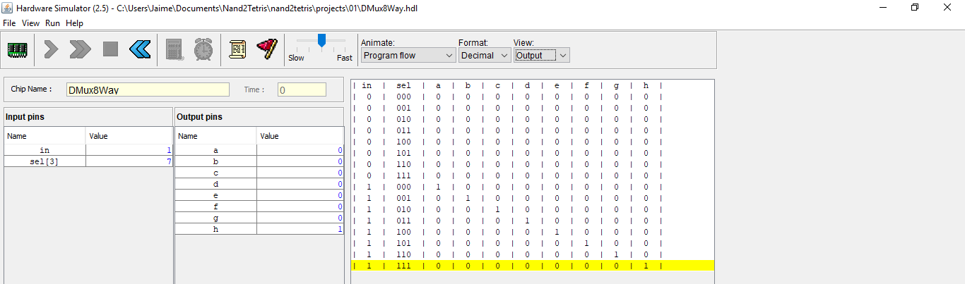
Multi-way and multi-bit gates dmux8way
/**
* 8-way demultiplexor:
* {a, b, c, d, e, f, g, h} = {in, 0, 0, 0, 0, 0, 0, 0} if sel == 000
* {0, in, 0, 0, 0, 0, 0, 0} if sel == 001
* etc.
* {0, 0, 0, 0, 0, 0, 0, in} if sel == 111
*/
CHIP DMux8Way {
IN in, sel[3];
OUT a, b, c, d, e, f, g, h;
PARTS:
DMux(in=in, sel=sel[0], a=outad, b=outeh);
DMux4WaY(in=outad, sel=sel[1..2], a=a, b=b, c=c, d=d);
DMux4WaY(in=outeh, sel=sel[1..2], a=e, b=f, c=g, d=h);
}
a = 0
b = 0
c = 0
outad = 0
d = 0
in = 1
outeh = 1
e = 0
f = 0
g = 0
h = 1
3
sel = [1,1,1]

Slide 127
Other gates equal
/** Checks if two 3-bit input buses are equal */
CHIP EQ3 {
IN a[3], b[3];
OUT out; // True iff a=b
PARTS:
Xor(a=a[0], b=b[0], out=c0);
Xor(a=a[1], b=b[1], out=c1);
Xor(a=a[2], b=b[2], out=c2);
Or(a=c0, b=c1, out=c01);
Or(a=c01, b=c2, out=neq);
Not(in=neq, out=out);
}
CHIP EQ3
IN
OUT
a[0] = 0
c0 = 0
a = [0,1,0]
b[0] = 0
3
c01 = 0
a[1] = 1
out = 0
b[1] = 1
neg = 1
c1 = 0
b = [0,1,1]
3
a[2] = 0
b[2] = 1
c2 = 1

Slide 128
Other gates equal
/** Checks if two 3-bit input buses are equal */
CHIP EQ3 {
IN a[3], b[3];
OUT out; // True iff a=b
PARTS:
Xor(a=a[0], b=b[0], out=c0);
Xor(a=a[1], b=b[1], out=c1);
Xor(a=a[2], b=b[2], out=c2);
Or(a=c0, b=c1, out=c01);
Or(a=c01, b=c2, out=neq);
Not(in=neq, out=out);
}
CHIP EQ3
IN
OUT
a[0] = 0
c0 = 0
a = [0,1,0]
b[0] = 0
3
c01 = 0
a[1] = 1
out = 0
b[1] = 1
neg = 1
c1 = 0
b = [0,1,1]
3
a[2] = 0
b[2] = 1
c2 = 1

Slide 129
Other gates equal
/** Checks if two 3-bit input buses are equal */
CHIP EQ3 {
IN a[3], b[3];
OUT out; // True iff a=b
PARTS:
Xor(a=a[0], b=b[0], out=c0);
Xor(a=a[1], b=b[1], out=c1);
Xor(a=a[2], b=b[2], out=c2);
Or(a=c0, b=c1, out=c01);
Or(a=c01, b=c2, out=neq);
Not(in=neq, out=out);
}
CHIP EQ3
IN
OUT
a[0] = 0
c0 = 0
a = [0,0,0]
b[0] = 0
3
c01 = 0
a[1] = 0
out = 1
b[1] = 0
neg = 0
c1 = 0
b = [0,0,0]
3
a[2] = 0
b[2] = 0
c2 = 0

Slide 130
Perspective
Implementation
Each internal part (Xor, Or, Not) refers to a stand-alone chip
Internal parts = black boxes → allows the designer to focus on their arrangement
HW simulator evaluates program → all the way down the recursive chip hierarchy → internal parts are expanded
into 1000s of interconnected elementary logic gates
Modularity → even high-level chips/programs are short and readable
Eg. a complex chip like RAM16K can be implemented using a few RAM4K chips, each described in a single HDL line

